Slide 1
Spring Has Sprung --- a LEAK ...in many areas of the market,...
AAPL
STZ
TOO HOT- HOT- HOT ---
MARCH JOB GROWTH= 303,000 !
CA Minimum Wage is now $20/HR!
UNEMPLOYMENT @ 3.8%
Eight states have lowered the age for working child labor laws down to 15 and 14 year olds & loosened
restrictions on job types and job hours worked.
Personnel shortages in every job category---
Karen Kamenir
CPI Number UP to 3.5%
WRONG Way
Retail # UP Too HOT

Slide 2
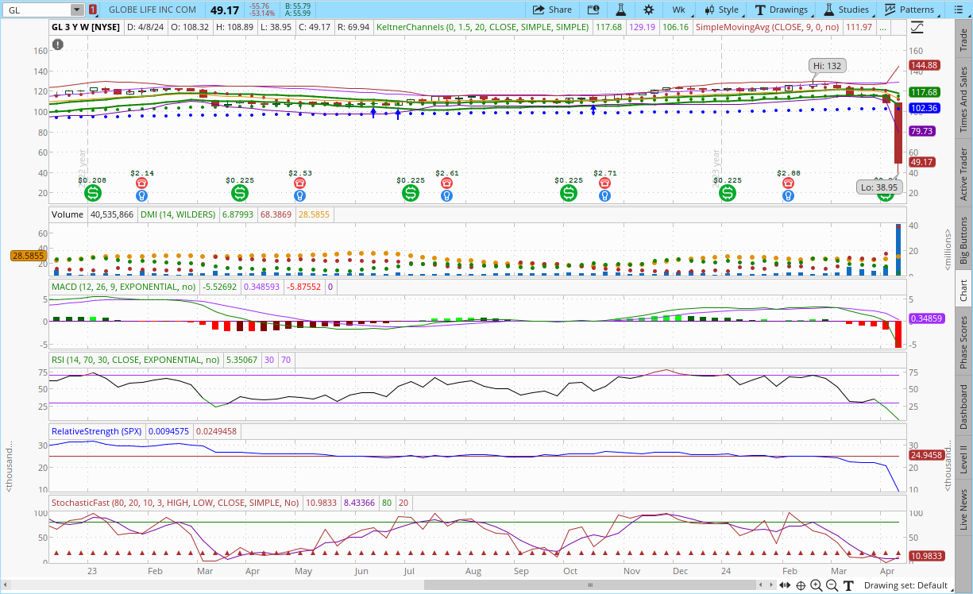
Fuzzy Panda
--- A Meme
Take
Down
Stock
Down
$55+
In
One
Day

Slide 3
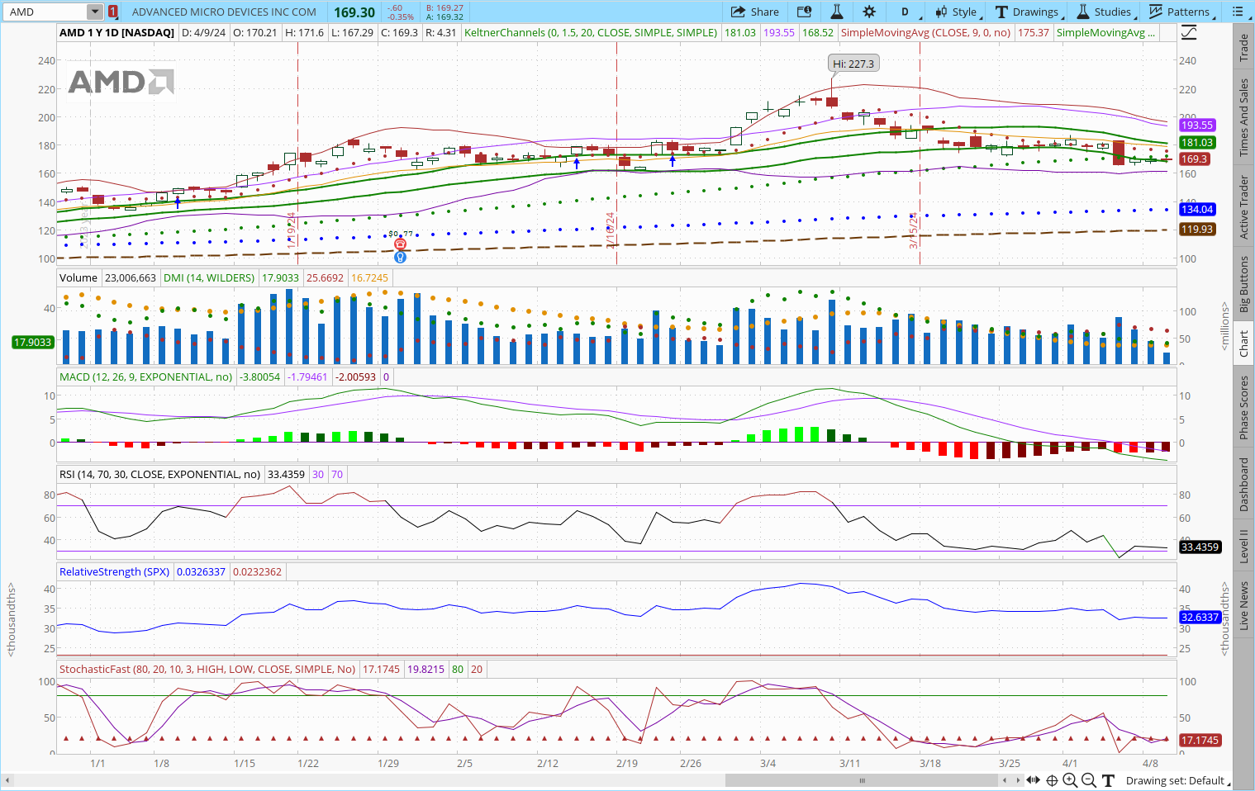
AMD is a tech stock
AMD is an AI stock
Opps!
Fell
20% in a month

Slide 4
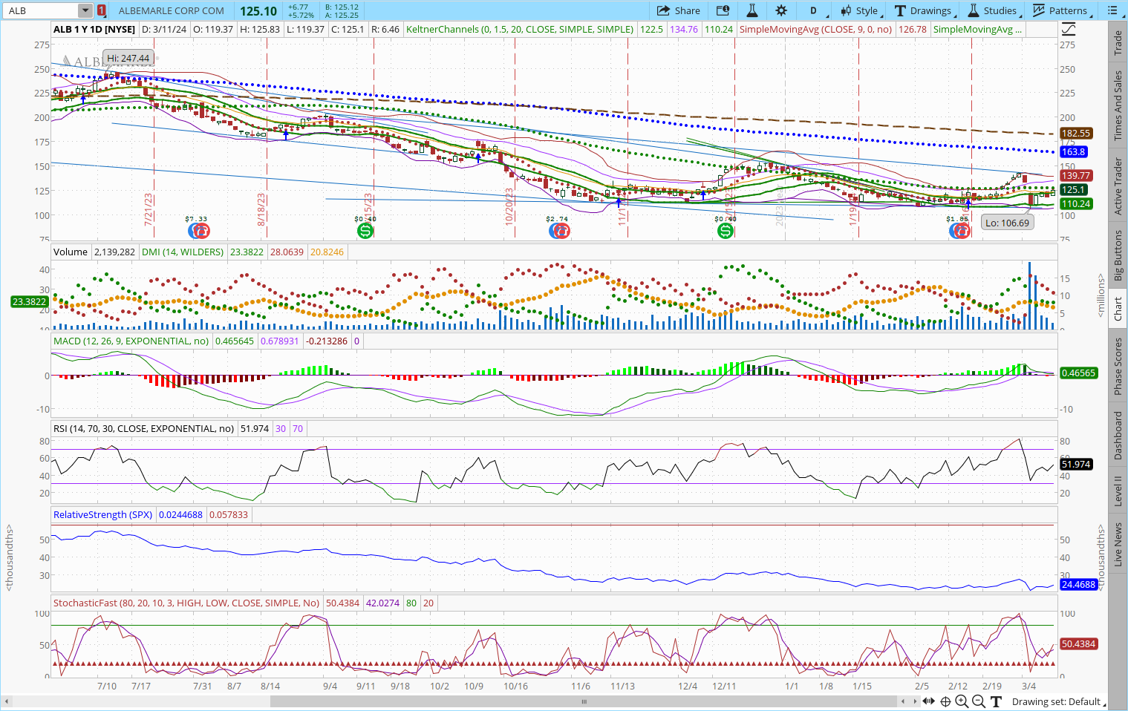
NEW
TARGET
PRIC
E
$ 85 - $112

Slide 5
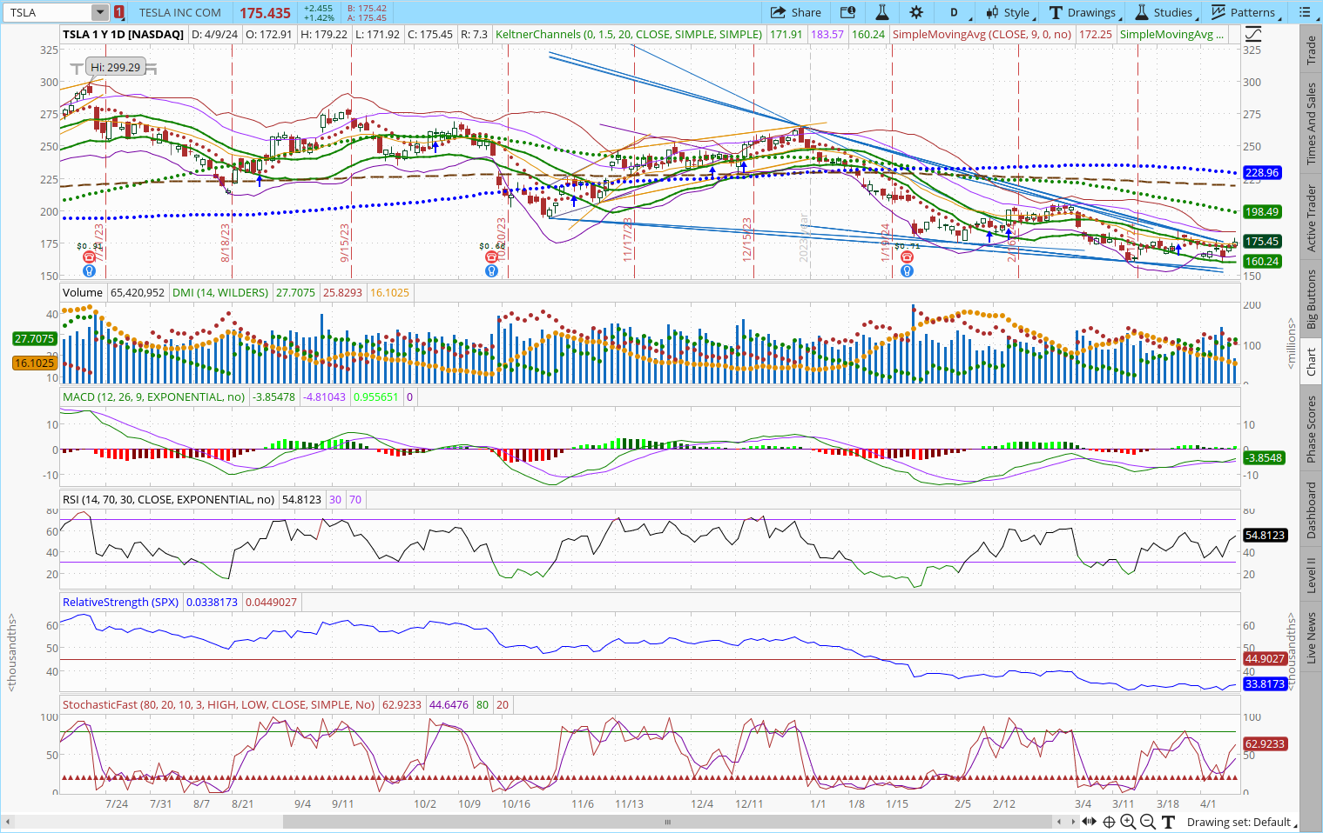
TESLA delivered
9% fewer cars YOY.
TSLA is down 33% in 2024.
TSLA’s
worth
dropped
from its peak in November 2021
more than
$1.2 Trillion!
Lay-off 10% ---

Slide 6
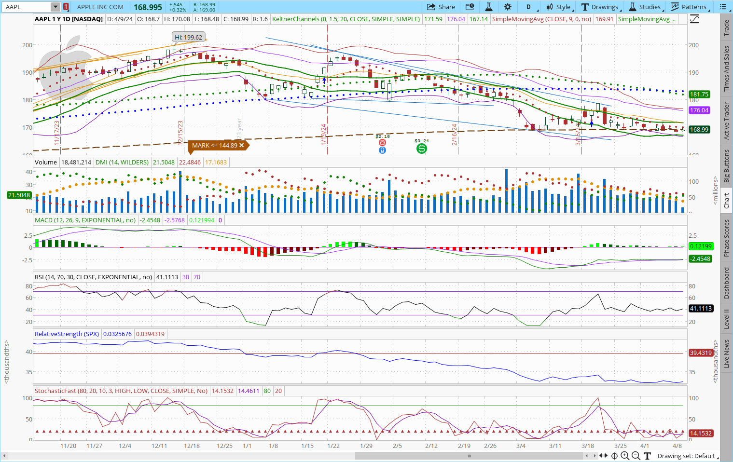
$2
B
I
L
L
I
O
N
FINE
HURT

Slide 7
REITS --- exposure to CRE? – or? BE CAREFUL of what you own in this arena:
DOWNGRADES:
HPP: Hudson Pacific Properties
Once was a $30 stock and is now trading at $6+ They own 48 properties and 6 motion picture studios.
I see headwinds coming into the motion picture industry giving way to foreign products.
HR: Healthcare Realty Trust Inc.
Once trading at $33 and is now trading at $13. They own 688 healthcare properties in 35 states.
Outpatient services over-done during Covid? Only has 85% occupancy rate & need over 90%+
DLR: Digital Realty Trust (*I own – I will keep)
Once was a $178+ stock the fell to $85. It is now trading at $146+/. Mitsubishi acquired 2 data centers/partnership.
DLR customers are Meta, IBM, VZ, JPM, ATT etc. for a total o 4,000 customers in social media, finance & telecoms.
WPC: W P Carey Inc.
Once trading at $89+, fell to $51 and is now trading at $58+.
They have exposure to the industrial warehouse space & self storage. They cut their dividend from $1.06 to $.86.
Demand during Covid exploded, so that is gone now. But automated, digitized warehouses may become in demand.

Slide 8
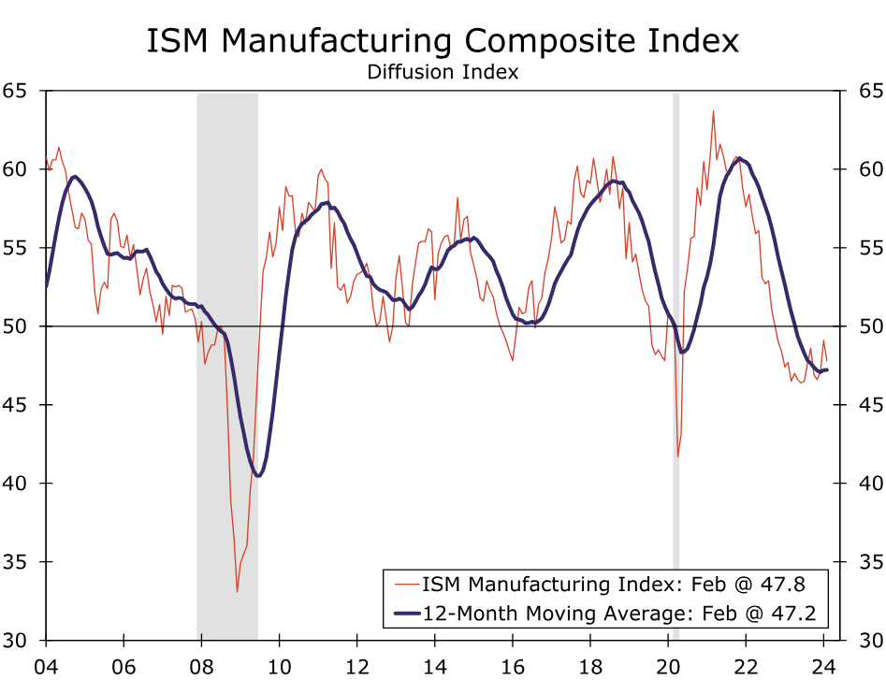
This area still has to play catch-up, March 1:
The ISM has been in contraction for 16-straight months, and employment fell to its second-lowest reading since 2020.
It came in at 47.8. New orders declined by 3.3.
There may be signs of life but it will show up in the services ISM as that is the bigger driver of overall hiring (?)

Slide 9
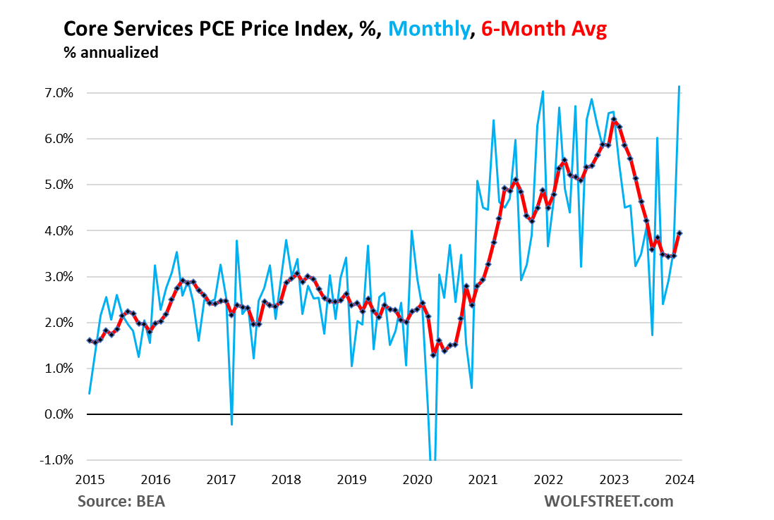
NO Hurry
...to cut rates
PCE bounced back up to 3.9%. Of the 7 categories, housing accelerated to 6.4% Jan. to Dec., ‘23.
FED Governor Michelle Bowman said she could raise rates if this isn’t reversed*. 3-1-24
3-7-24: The U.S. trade deficit hits an 8th month low threatening our risk to Q1 real GDP growth.

Slide 10
A REMINDER: THE NUMBER OF PUBLICLY TRADED COMPANIES IN THE U.S. IS SHRINKING
At their peak in 1996, there were 7,300 publicly traded companies in the US. Today there are about 4,300.
The number of private companies in the US backed by PE firms has grown from:
1,900 to 11,200 over the last two decades, according to JPMorgan data. Additionally, a company owned by a PE firm can obfuscate ownership & what the company does, and hide its profits from the public and from regulators.
It’s not that America has 40% fewer companies than it did 30 years ago, it’s that companies are increasingly staying private, largely outside the scrutiny of the public eye. “The total should have grown dramatically, not shrunk,” wrote Dimon, CEO of JPMorgan Chase, in his annual shareholder letter on 04-08-24.
Dimon’s comments on earnings: Companies might “take short-term actions to increase earnings, such as selling more product cheaply at the end of a quarter, cutting certain investments that may be terrific but can show accounting losses in the first year or two, or just deploying more aggressive accounting methods at times,” he wrote.
“Once shortcuts like this begin, people all over the company understand that it is okay to ‘stretch’ to meet your numbers. This could put you on a treadmill to ruin,” he said.

Slide 11
AND YET, BANK OF AMERICA
SEES THE S & P 500 CLIMBING
TO
BEFORE Year End, even if we get a summer dip!
From Wells Fargo: The API (Animal Spirit Index) has climbed every month and is now equal to April, 2019
Earnings kick off 04-12 with ADM, INTC, TXN, NVDA, MU reporting – then IBM, MSFT, and GOOG

Slide 12
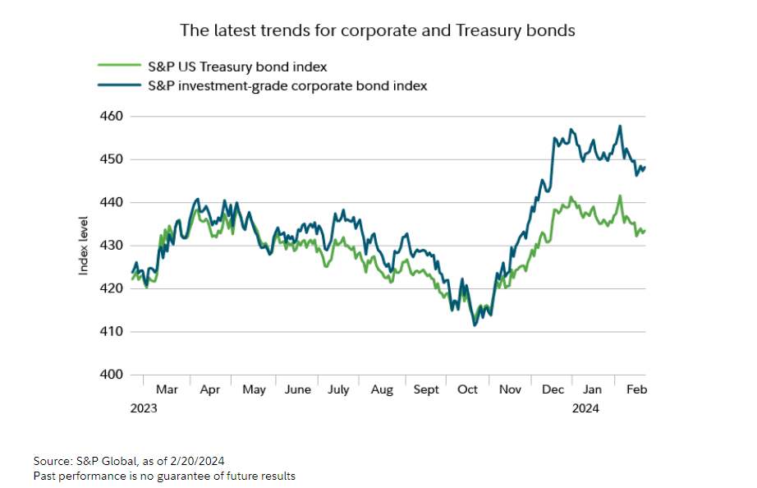
Bonds ?
If we avoid a recession, Treasurys might not out-perform but may still provide safe yields.
Medium-term Corporate bond:
Buy when prevailing rate is the same as the coupon rate (100). Those could benefit when the rates are cut.
Sell when the yield to maturity now matches the new prevailing rate. As rates fall, buyers will pay extra for your bond

Slide 13
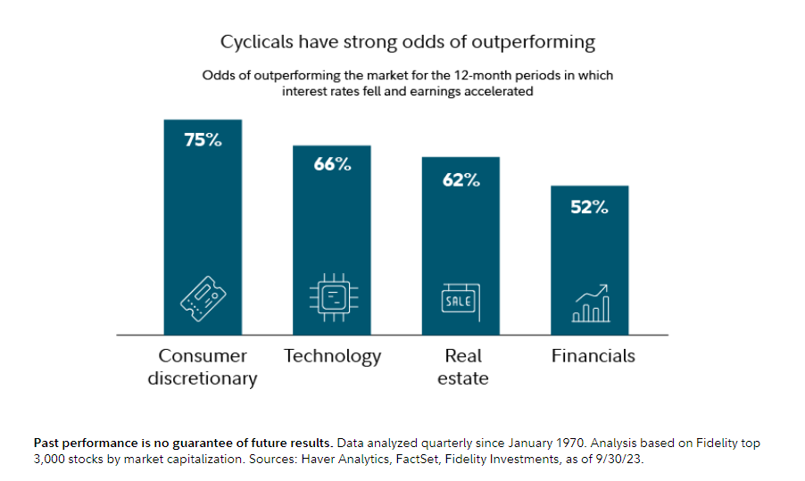
RATES ?
When they DO fall – it’s good for the market as it generally out-performs over the next 12 months.
Small Caps may finally rally. & since 1970 outperform large caps 76% of the time over those same 12 months.

Slide 14
The same week that Tim Cook announced that Apple would throw in the towel on its EV car project,... (A one $Billion a year boondoggle)
Henrik Fisker may be following the lead.
Maybe Fisker will get a life-line from Nissan Motor Co. as they are in talks.
New EV car start-ups are just not able to cut it with the existing competition.
There is a YouTube video with a 20 minute rant called:
“ This is the Worst Car I’ve Ever Reviewed”
Fisker CEO Henrik Fisker introducing an off-road version of the Ocean called the Force E. Photographer: Frederic J. Brown/AFP via Getty Images

Slide 15
YET ---- there is some bright new options for those EV road trips:
American car buyers demand more range from electric vehicles than drivers in any other country.
For years, a few models made by Tesla were the only long-range game in town, but that era of scarcity is over. The number of EV options that can go 300 miles or more on a charge jumped to 30 models at the beginning of 2024, a 500% increase in three years. An additional 20 are set to go on sale later in the year, according to a new analysis by Bloomberg Green. *Globally, the number of charging stations is forecasted to increase from 5.8 Million in 2024 to 28.9 Million by 2034. The U.S. is lagging --
Improvements in range and affordability helped boost sales of fully electric vehicles in the US, which accounted for 8% of all new cars in the US last year. Growth in sales is expected to slow in 2024.
AND GOOD news on recycling those batteries: By 2035, some 3.7 million metric tons of batteries could be nearing the end of their lives. Pull them apart to repurpose their innards, and you could have 10-18% of the key materials needed for battery manufacturing.

Slide 16
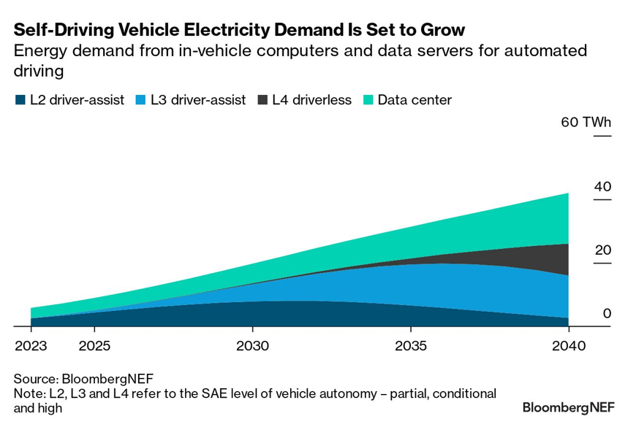
In-Vehicle Computers
For an EV with a Level 4 highly automated self-driving system – well, it will use up to 46% of its power consumption to power the computer software system.
Chipmakers like Nvidia, Mobileye and AMD are developing new versions to improve energy efficiency.
This chart tries to break down the demand among these different areas that are sucking up power.*

Slide 17
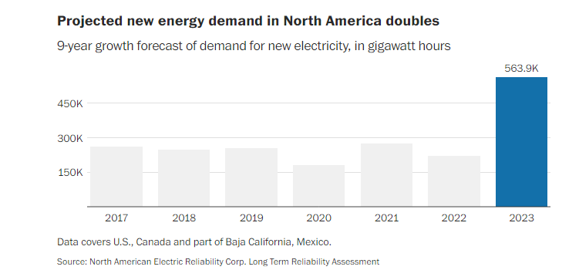
The U.S. is at risk of running short of power as electricity-hungry data centers & clean-technology factories proliferate around the country, leaving utilities regulators grasping for credible plans to expand the nation’s creaking power grid.
In Georgia, demand for industrial power is surging to record highs. Projection of electricity use for the next decade now 17 times what it was only recently. Arizona Public Service, the largest utility in that state, is also struggling to keep up, projecting it will be out of transmission capacity before the end of the decade absent major upgrades.
Northern Virginia needs the equivalent of several large nuclear power plants to serve all the new data centers planned and under construction (FOR AI*). Texas, where electricity shortages are already routine on hot summer days, faces the same dilemma. (Refer to the Excel Utility cause of fire in Texas in March & we know about California utility issues).
San Antonio has a huge single family home growth spurt --- there is concern with how to now power those homes being built !
*P.S. New home prices start @ $279,900 there.

Slide 18
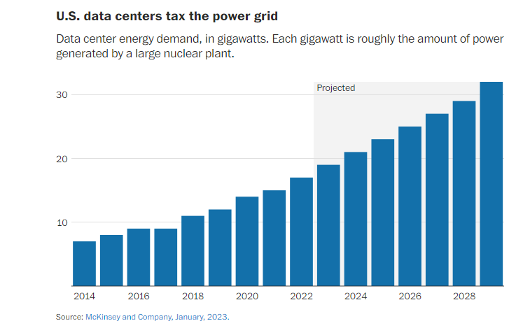
The worry is that residential ratepayers will be stuck with the bill for all this new build and upgrades.
The U.S.’s 2,700 data centers sapped more than 4% of the total energy in 2022 with projections that show 2026 consuming 6%
Meanwhile,... We are luring more businesses to build and manufacture in the U.S. The most since the 90’s
So far, 155 NEW factory builds have been announced just within the last few years.

Slide 19
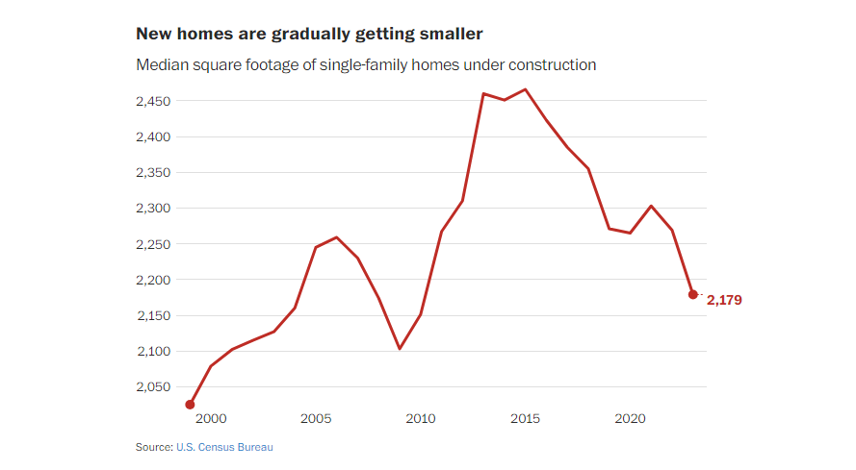
Shrinking
Smaller construction has cut the size of new homes being built by 4% and has helped to bring down costs by 6% -- *think fewer windows, cabinets, doors. *DR Horton now has a floor plan at 900 sq. ft.
This is a trend driven by unaffordable housing &to lessen utility costs& maintenance.

Slide 20
HOME DEPOT, LOWE’S, BEST BUY! THE HOME FIXER-UPPER DAYS MAY BE GONE!
Home Depot is expanding its business targeting professional contractors and builders as the home fixer-upper market stalls. Home Depot announced 03-28-24 that it is spending $18.3 billion to buy SRS Distribution, a huge building-projects supplier that counts professional roofers, landscapers and pool contractors as its primary customers. SRS will operate independently, with 760 warehouses and 4,000 trucks to deliver its goods.
Home Depot, the nation’s fifth-largest retailer, currently gets around half of its sales from housing professionals, who spend more at stores than do-it-yourself homeowners purchasing lawn mowers & power tools. Home Depot said that sales dropped over the winter and it’s a expecting a sluggish 2024. Demand for home improvement projects has also fallen due to high mortgage rates and a tough real estate market climate. In October, mortgage rates hit a 23-year high of 7.79%. (*Add to that, the new realtors settlement on commissions.) Their maybe regulatory hurdles (?)
Lowe’s: The home improvement giant projected total sales of $84 to $85 billion for 2024 in fourth-quarter results. That’s below the $86.4 billion in sales it raked in during 2023. “We expect DIY projects to remain under pressure.”
Best Buy: The company projected revenue between $41.3 billion and $42.6 billion for the 2025 fiscal year, down from the $43.5 billion revenue it generated in the fiscal 2024 year. CEO pointed to “consumer’s prioritization of food & lodging, and continued spending on experiences over goods”

Slide 21
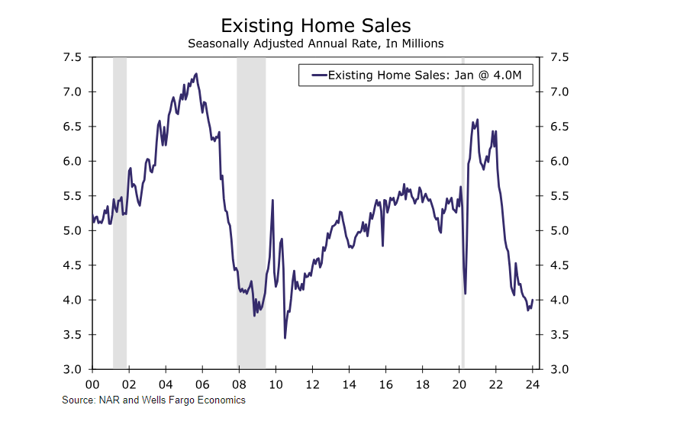
Mortgage Applications Fell
Existing home sales fell 19.4% to a 4.1 million unit pace in 2023 marking the 2nd straight steep annual decline.
Mortgage rates are expected to fall to 5.8% by 4th Qtr. of 2025 - that should help.
Currently, most existing mortgage rates are well below 5% --- over 1/3 are between 3-4%= nice!

Slide 22
Land is bought – in unusual places for big $$$
In various parts of the country there are fights over who gets the power grid upgrade.
(Maryland is an example)
First come first serve ---
Crypto miners don’t build renewable energy projects
Data center users like Google and Meta do try to consider renewable energy
I like owning utilities, but NOW – who should I own?
The Cormint Data Systems bitcoin-mining facility in Fort Stockton, Tex.
(Jordan Vonderhaar/Bloomberg News/Getty Images)

Slide 23
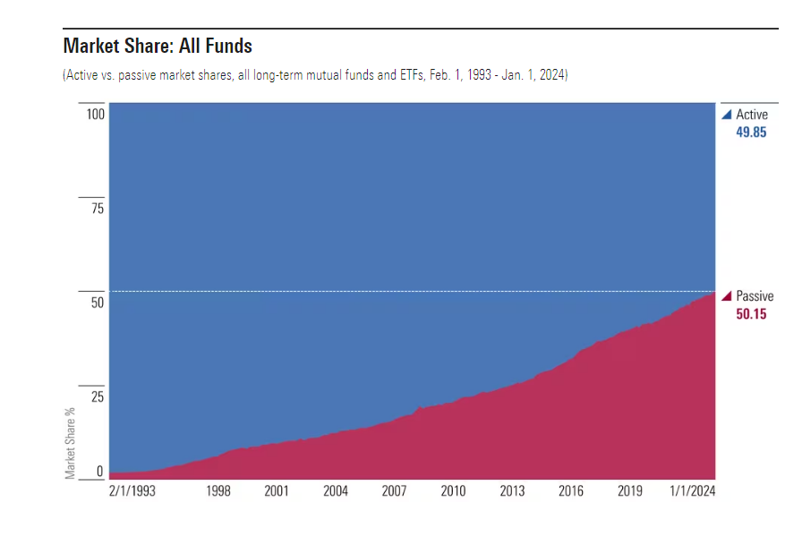
ACTIVE vs PASSIVE
In 2015 index mixes like mutual funds and ETFs exceeded the 30% level. Now look!
Could Indexing become so powerful that it disrupts markets? Could AI adjust the percentages held?
Blackrock & Vanguard are the biggest index providers
*Not in American history have so few controlled so much money.
But many of us as we age may move to these types of holdings rather than owning individual stocks?? Turning to more of a “KISS” picture.

Slide 24
Uncle Sam has quietly deployed a secret weapon designed to catch bad guys trying to steal from taxpayers: AI
Around late 2022, the Treasury began using enhanced fraud-detection methods powered by AI to spot fraud. *CNN
The strategy mirrors what is already being done in the private sector. Banks and payment companies are increasingly turning to AI to root out suspicious transactions – which the technology can often do with lightning speed.
Treasury’s AI-powered fraud detection recovered $375 million in fiscal 2023 alone, Treasury officials tell CNN, marking the first time Treasury is publicly acknowledging it is using AI to detect fraud.
Using these new crime-fighting strategies can halt check fraud almost in real-time in part by looking for unusual transaction patterns, And this focus on AI has led to multiple active cases and arrests by law enforcement. *CNN
Recently, while doing volunteer work for AARP Tax Assistance, one client’s tax report didn’t want to go through. The computer message stated that the 2023 tax filing had already been filed.
This apparently is a result of identity theft?!
This opened up a case in which AI didn’t prevent, but perhaps can assist in tracing and “catching” the bad guy.
From January ‘23 to September ‘23 there were 805,000cases of identity theft reported with most being credit card fraud

Slide 25
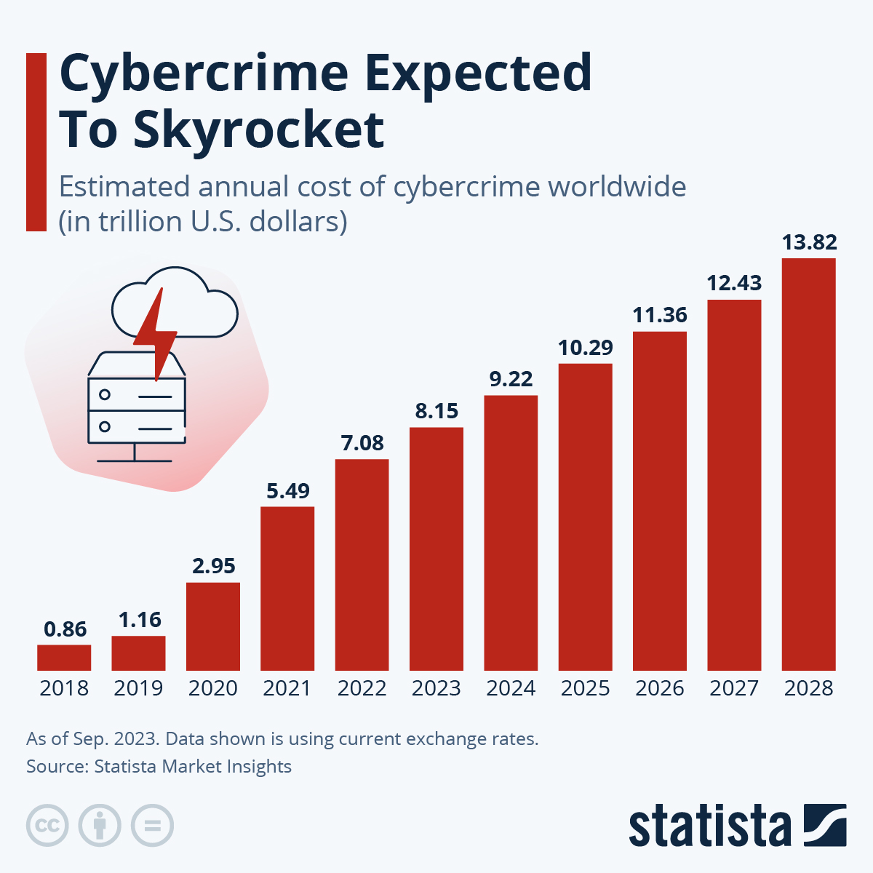
You may be thankful that the IRS is your only concern. Take a look at these cybercrime projections on the chart to the left:
The Cybersecurity and Infrastructure Security Agency (CISA), the National Security Agency (NSA) & the Federal Bureau of Investigation (FBI), has issued a warning!
Names like “Volt Typhoon” and “Vanguard Panda” and “Bronze Silhouette” have breached critical IT environments in the U.S. Financial losses from cyber-attacks in 2022 ran approximately $10.3 BILLION
12% of the attacks are politically motivated stemming from China, Russia, Iran, and N. Korea which are the top four contributors.
Which stocks could benefit? NET, GEN, CRWD, S or an ETF like VGT, CIBR, HACK. ?Study --

Slide 26
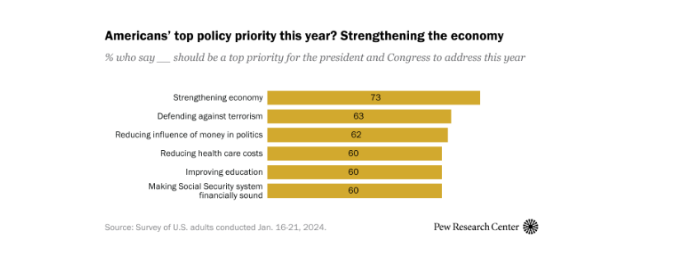
Across 24 surveyed countries, a median of 59% of adults are dissatisfied with how democracy is working
A median of 31% across 24 nations are supportive of authoritarian systems. *Pew Research Center
Below are results of a recent U.S. survey of “what is a top priority for the President and Congress

Slide 27
Fidelity Investments found that the number of employees with 401(k) balances over $1 million rose 41% in the 4th qtr. of 2023.
Fidelity Investments, one of the largest administrators of workplace plans, said it had 422,000 401(k) millionaires at the end of 2023, a nearly 21 percent increase from the 3rd quarter.
The number of IRA millionaires hit a record 391,562 in the fourth quarter, about 40 percent higher than a year earlier.
That same day Bernie Sanders held a hearing to decry the demise of corporate pensions and the lack of retirement savings a month nearly HALF of American households. They are BOTH right.
Barron’s 3-3-24
Washington Post illustration
*The average age of these newly-minted millionaires is 59
*The median balance among the millionaires is $1.34 Million
Another great divide exits --- according to American Community Survey’s 5 yr. estimates; we have approximately 327,000 homeless people.

Slide 28
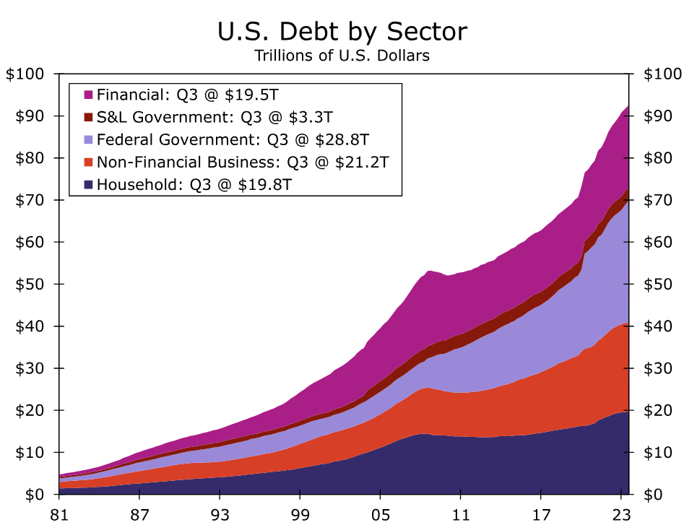
Every sector of the economy took on debt --- much of it in the last 4 years.
BUT our debt to GDP ratio is currently at 334% ---
That is lower than the peak at 2nd Qtr. of 2019 coming in at 368%!

Slide 29
WELLS FARGO Economics February 22,2024 Report:
Household debt stands more than $5 trillion higher today than it did at the commencement of the global financial crisis. But, household income has outpaced growth in debt over that period, so household sector is less leveraged today than it was in 2008.
Mortgages account for 70% of total household debt, with most originated at fixed rates. Underwriting standards for mortgages are considerably tighter today. Nearly 70% of the mortgages that have been originated in recent years have been to homeowners with FICO scores that are "very good“ (*740) or "exceptional.“ (*Tighter banking standards for folks seeking mortgages)
The amount of student loan debt has ballooned in recent years, but more than half of borrowers have less than $20K worth of student loan debt. The delinquency rate on student loans, which was depressed because of the moratorium on payments that Congress approved during the pandemic, will move considerably higher later this year now that the moratorium has ended.
Auto loans have also grown in recent years. The delinquency rate on auto loans has trended higher, although it remains below rates that prevailed prior to the financial crisis.
The outstanding amount of revolving credit has also grown significantly over the past decade or so. (?Low income consumer breaks?)
Deleveraging since the 2008 housing bubble, has led to a decline in the debt service ratio for the household sector. The amount of amortization and interest payments that the household sector, as a percent of its disposable income, essentially sits at the lowest ratio in at least 40 years. The financial position of the household sector, in aggregate, appears to be generally solid at present, although younger and less affluent households may be starting to experience some financial stress.

Slide 30
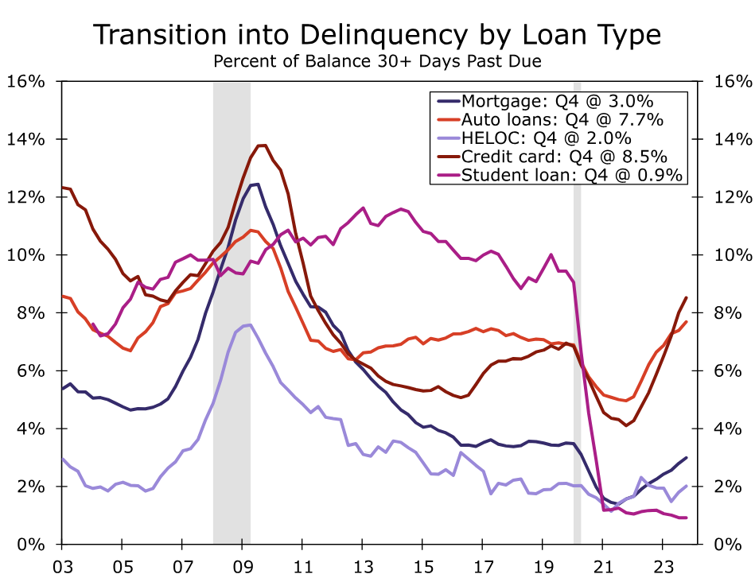
It seems to be the Gen Z and Millennials – the youngest and those with low income are showing signs of stress.
Many households re-financed mortgages when the interest rates were so low.
See the NEXT chart
Source: New York Fed Consumer Credit Panel, Equifax and Wells Fargo Economics

Slide 31
We just don’t have a bifurcated market, we have a bifurcated consumer as well, with a deeper/greater divide
You can see this by watching the earnings reports of some retail stores – high-end or lower-end consumer:
Retailer Macy’s (M)?: 4th -quarter profit beat estimates and rose from a year ago. The bad news?
Forecasts for full-year earnings and revenue missed targets, and the company said it would close a third of its Macy’s-branded locations, (about 150).
It will add Bloomingdale’s and Bluemercury (*I had to look this up bluemercury.com ---- where I found on-line products for women AND where I spotted a facial cream for over $2,600+ as well as a spa candle that sells for over $100). Management wants to focus on more-upscale retail operations. Meanwhile, buyout firms are circling in the background – though Macy’s has so far rejected their overtures.
Finally, “surge pricing” is coming for your burgers and fries! Fast food purveyor Wendy’s Co. (WEN) is upgrading to digital menus at many locations, and as part of that move, planning to charge higher prices when its products are in higher demand. Expect a hamburger to cost more during the lunch rush than it might in the middle of the afternoon, just like an Uber Technologies (UBER) ride costs more at rush hour or when it’s downpouring outside.

Slide 32
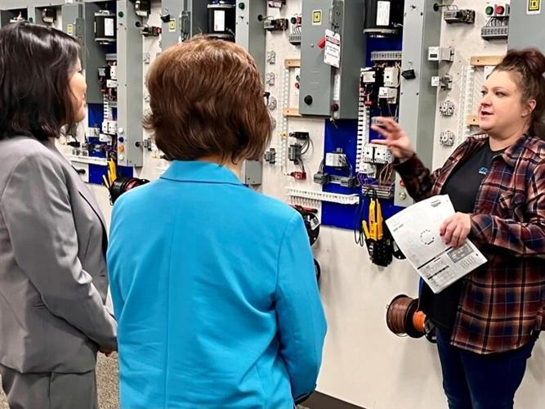
*Picture: Acting US Labor Secretary Julie Su speaking at an electrical training ctr.
The center is trying to attract women & those recently released from jails/prisons to enter the apprenticeship programs.
A trio of laws passed in 2021 and 2022 worth over $1 Trillion made to improve bridges, roads, and expand capacity for making computer chips etc.
In Oregon, a program called Future Ready Oregon approved $200 Million for training in health care & manufacturing for women & others.
We BADLY need trained trade-workers who EARN more money to SPEND.
SIDE-NOTE: While visiting a Big Bend, TX resort restaurant, I realized I was being served by nearby cell inmates.

Slide 33
** SEEING MORE GRANDMA’S RAISING KIDS & MORE SINGLE MOM’S WORKING 2 JOBS
Training for women in EVERY sector is a motivational hot-button for me! WHY?
The average income of a single mother in the US is $28,000 in the 25th percentile and $51,500 in the 75th percentile.
(*ziprecruiter.com) *The national avg rent for a 2-bedroom apartment runs just under $1500/month = $18,000/year
One in Five children are being raised without a father. The poverty rate for women led households is at 27%
*More than 33% of single-mother households reported food insecurity in 2022.
It is too difficult for most fathers to support TWO households after a divorce. (CNBC)
AND in later years ----
70% of all married women will experience widowhood
80% of married women will die single (seldom do they re-marry after becoming a widow)
80% of married men will die married (Most all DO remarry after a divorce or after becoming a widower)

Slide 34
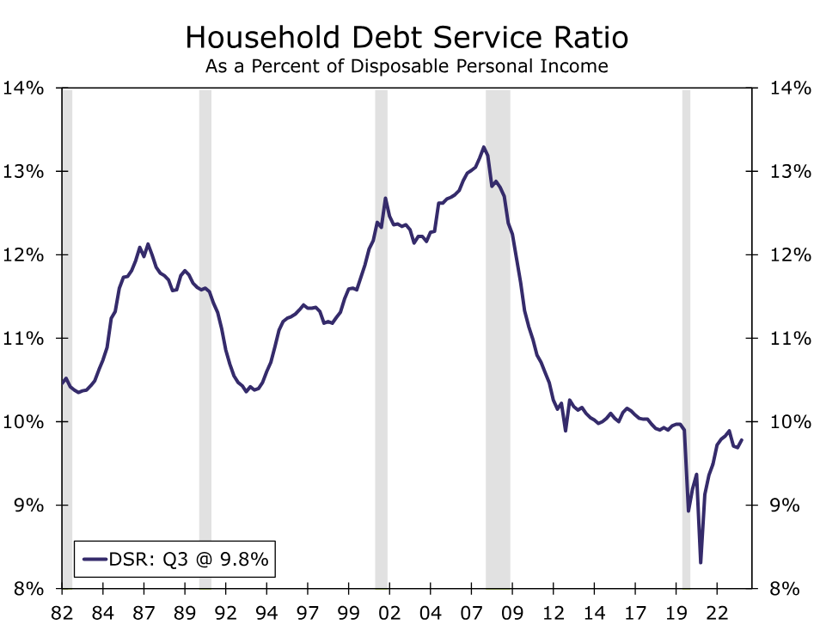
Surprise,...
the debt service ratio is near its lowest level in at least 40 years.
With fixed rate mortgages accounting for a large proportion of total household debt, it likely will be years before the ratio approaches the high it reached at the peak of the housing bubble.
Source: Federal Reserve Board and Wells Fargo Economics

Slide 35
PRIVATE CREDIT IS NOW VERY LARGE --- IT COULD BECOME TOO INFLUENTIAL --
A Potential Problem in the Shadows?: Private Credit Lurks in the Shadows
A fast growing segment of business credit appears to be flying below the radar.
Private credit, or direct lending to businesses by non-bank institutions, has swelled over the past decade.
Data from the Federal Reserve show total assets under management at private credit funds more than trebled from around $345 billion in 2012 to just over $1 trillion in 2022.4
Total NFC debt increased just 89% over the same period. Moreover, the size of the private credit market appears to be closer to $1.6 trillion today, but estimates vary; data are limited because private funds generally do not disclose as much information as banking institutions under current federal law.
Think high net worth individuals going through closed-end funds who pool their funds. A 2021 survey showed that ½ of the portfolio companies would not have been able to get traditional bank financing.
Add to that, there is not regulatory and supervisory oversight, so be weary if you can afford to enter!
Most loans provided are floating rate and carry high rates – of which I am sure will be “sticky”.

Slide 36
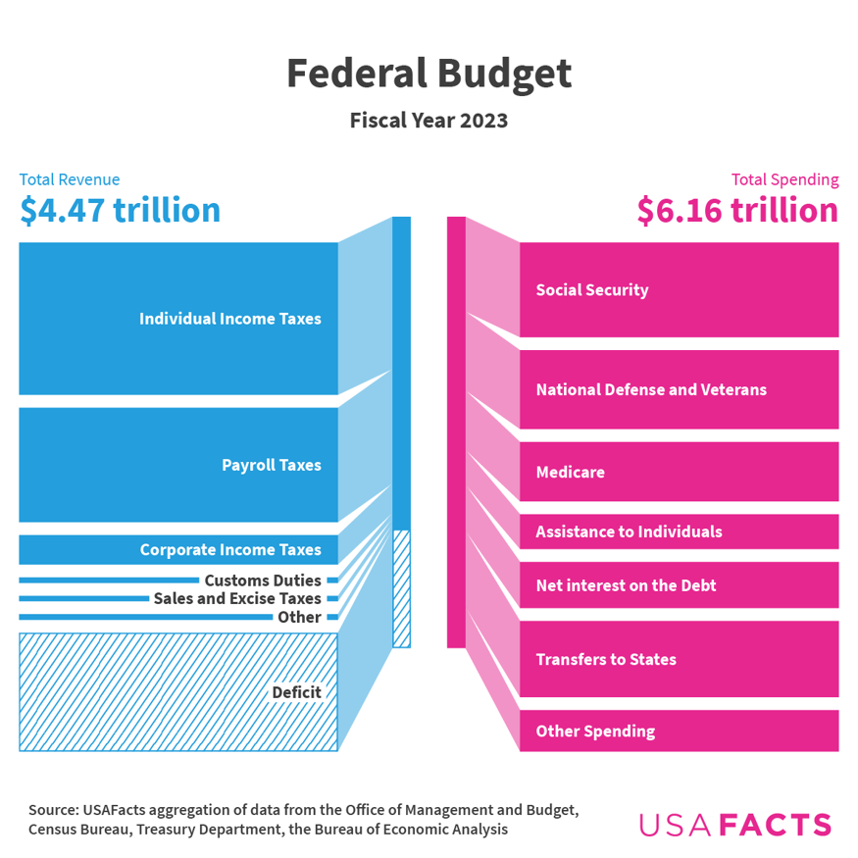
•Federal revenue = $13,341 per person.
(*Top 1% paid more than 90% tax revenue)
The government spent $18,406 per person.
Per-person fiscal year 2023 revenue was 4% higher and spending was 63% higher than in fiscal year 2000. Oh-OH!
Governments have to be run like your business or household. IF it’s good debt it’s okay,... But?
NOTE: find the block for corporate taxes
In 2021: Corporate income taxes accounted for 6% of the total U.S. tax revenue and individual taxes came in at over 42%. (*OECD)

Slide 37
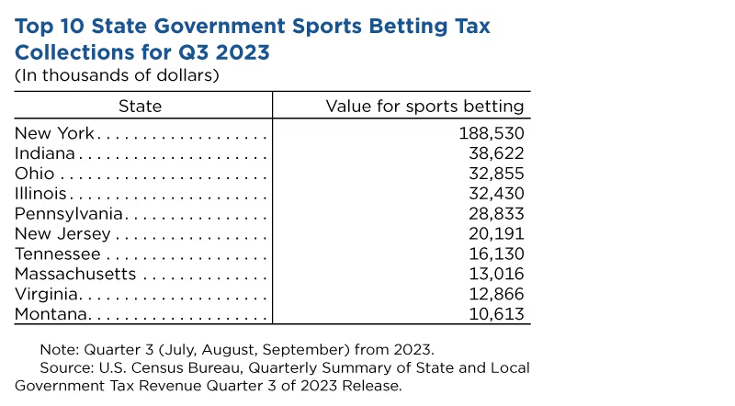
I “BET” THE BETTING IN NEVADA WILL BREAK ANOTHER “BETTING” RECORD ON 2025
I “bet” the local governments like all the sports betting – it’s a great source of revenue!!
In the third quarter of 2023, the most recent version of the QTAX, (Quarterly Survey of State and Local Tax Revenue) sports betting generated national state level sales tax and gross receipts of $505.96 million,
up 20.5% from the same quarter a year before,
but down from $571.48 million, the 2nd Qtr. Of ‘23.
26% of adults in the U.S. gambled on the Super Bowl Game of 2024.
FanDuel said it wrote 14 Million Super Bowl Bets for $307 Million.
Vegas broke betting history: Per Nevada Gaming Control Board, wagering came in at $185.6 Million

Slide 38
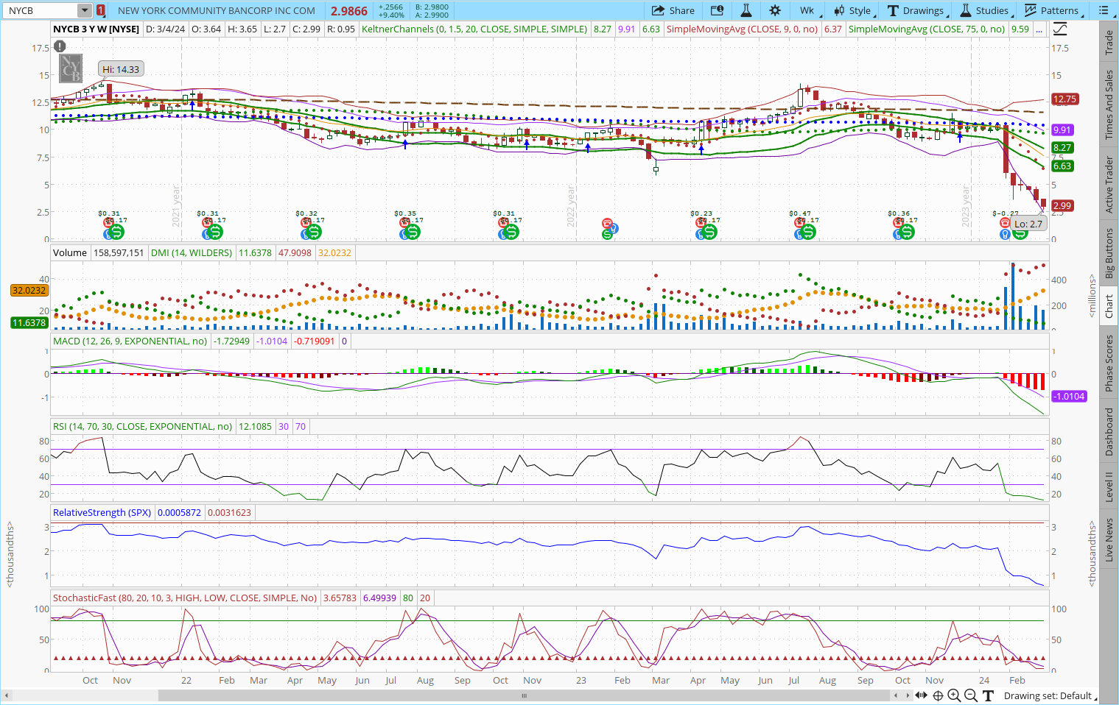
NYCB
This bank bet on CRE --- and lost!
New York Community Bank:
Bank reports $2.4 Billion earnings hit
...And the C.E.O. resigns
*They did get a $1Billion lifeline??
--- so I maintain my theme of be very careful if you own REITS – know what’s in them!

Slide 39
PUBLICLY TRADED BANKS WITH HIGH CONCENTRATIONS OF CRE LOANS / BARRON’S
VALLEY NATIONAL BANKCORPF/ VLY
COLUMBIA BANKING SYSTEM / COLB
BANK OZK / OZK (*Disclosure: I own)
SIMMONS FIRST NATIONAL / SFNC
WAFD / WAFD
AXOS FINANCIAL / AX
INDEPENDENT BANK / INDB
MERCHANTS BANCORP / MBIN
SERVISFIRST BANCSHARES / SFBS
DIME COMMUNITY BANDSHARES / DCOM
Note: Regulators look at
Commercial real estate loans exceeds 300% of capital and have grown 50% in the past 36 months
Construction & development loans (C&D) exceeds 100% of capital
Known data end of 2023: The banks listed above had over 300+%, 400+% & DCOM was over 500+% of loans to capital. The industry median normally runs about 125% for CRE & 30% for C&D

Slide 40
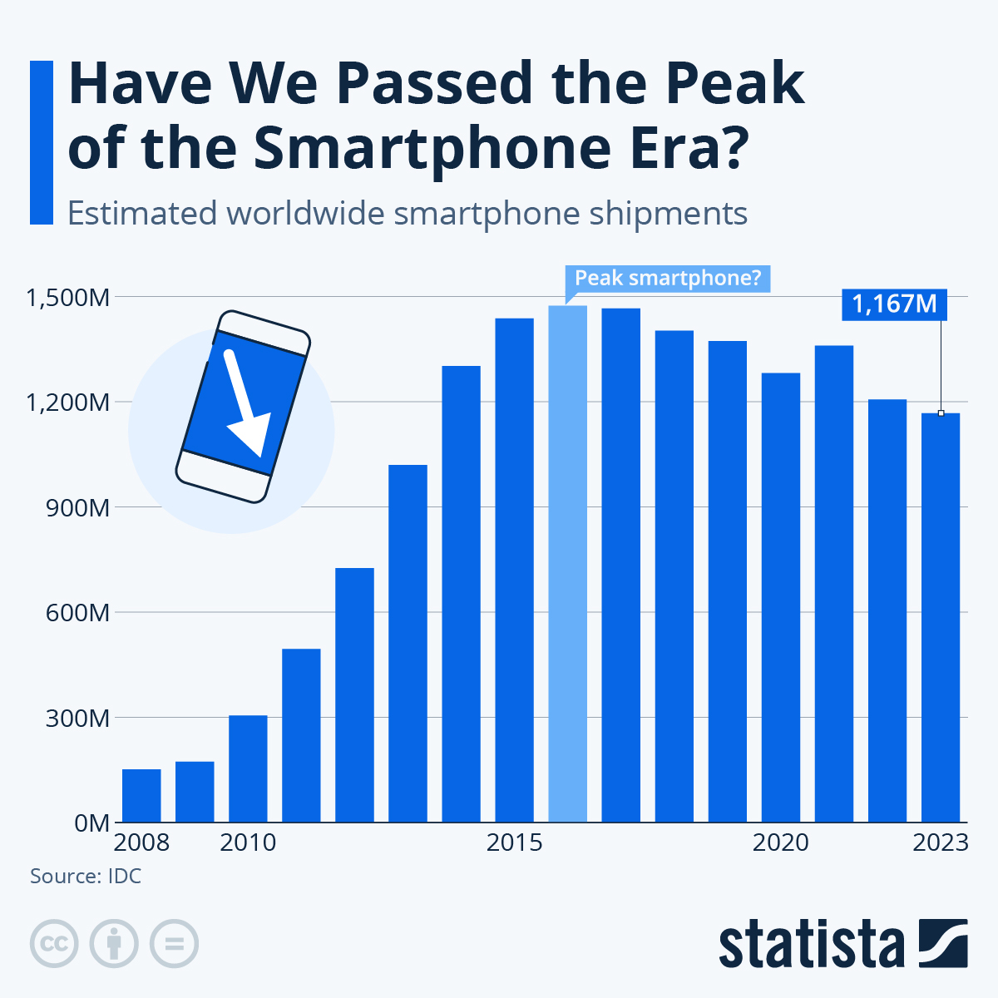
5G has thrown a lifeline to smartphone manufacturers struggling to survive. Last year smart phone shipments were down more than 20% from 2016 when smartphone shipments peaked.
The average price keeps going up, so margin will be the $-maker going forward.
In years to come will smart phone makers be the next SEARS??
(02-26-24)

Slide 41
2-23-24: Intel CEO Pat Gelsinger nudged US Commerce Secretary Gina Raimondo into saying a second US CHIPS Act, or other funding, is needed.
The main reason is that $39 billion for fab projects in the CHIPS Act created in 2022 is not going to be nearly enough to bolster future US chipmaking amid explosive AI demand, both Gelsinger and Raimondo agreed.
Drafting and passing a CHIPS 2 would be a huge undertaking with the current Congress, which expires early next year anyway. But that didn’t deter Gelsinger or Raimondo from stating the need during an onstage conversation. Raimondo spoke to the Intel audience of 1,000 people—including future potential foundry customers--on Wednesday via a live feed.
“I suspect we will need continued investment, whether you call it CHIPS 2 or something else,” Raimondo said. “If we want to compete globally, we have to continue to invest.”
The biggest award so far has gone to GlobalFoundries for $1.5 billion, plus another $1.6 billion in loans.

Slide 42
From Engineering News-Record:
US Commerce Dept. Prioritizes Projects Complete by 2030 for CHIPS Act Funding, Says Commerce Secretary
The Commerce Dept. has received more than 160 complete applications for funding of both projects worth more than $300 million & projects worth less than $300 million. Officials planned to put about $28 billion of the CHIPS Act funding toward projects that will manufacture “leading edge” chips used in the development of artificial intelligence. But those leading-edge chip makers alone have requested more than $70 billion.
The private sector has announced $200 billion in semiconductor manufacturing investments. Nine states have also created economic development programs targeting the semiconductor sector to provide matching funding.
The largest award so far is $1.5 billion announced this month for three GlobalFoundries projects in New York and Vermont. Smaller amounts of money have also been set for BAE Systems Inc. and Microchip Technology Inc.
Energy: Tennessee Valley Authority expects to decide in March whether it will spend $2.2 billion to replace its aging 1.5-GW Kingston, Tenn., coal-fired power plant with an equal-sized gas-fired facility it says could burn 5% hydrogen, coupled with a new 122-mile natural gas pipeline and 100 MW of battery storage.
The 70 year old 9 unit Kingston coal plant would be demolished

Slide 43
AND from Rail News: A Quick look at what is happening internationaly
Naples, Italy orders a new metro fleet from Hitachi.
Netherlands Railways (NS) has ordered 10) new variants of the Intercity New Generation (ICNG) high-speed train from Alstom for €150m, which will be equipped to operate in Germany and take traction current at 15kV 16.7Hz ac
L-Czech Railways (CD) has purchased 11) RS1 Regio-Shuttle diesel railcars from second-hand vehicle supplier Heros. The single-car vehicles will be refurbished by subsidiary DPOV and will be put into service in the Bohemia region
China is set to double the track in this area:
Work is due to start later this year on the doubling of the 399km Zhundong Temple - Hami Naomao Lake heavy haul line in northwest China
FROM THE RAIL PASSENGER ASSOCIATION IN THE U.S.:
Right now, European operators can place big orders for modern trainsets and expect deliveries within a few years at a cost of perhaps $3 million per railcar. In the U.S., that’s not even a remote hope. Amtrak’s big bet on bi-levels for long-distance service will be a rallying cry for rebuilding a rail industrial base worthy of the U.S. Whoever they choose in 2024 will be responsible for a lot more than just building 47 trainsets. The winner will shape the U.S. passenger rail landscape for the next half a century!

Slide 44
New Zealand’s national railway KiwiRail has signed 2 contracts with Stadler for the supply of 33 locomotives.
The first contract is for 9) DM 1067mm-gauge mainline locomotives for use on the North Island network. The diesel locomotives will be equipped with ETCS.
The contract also includes the equipping the final 10) DM locomotives from a €228m order for 57 units placed in 2021 with ETCS. This will take the total number of locomotives equipped with ETCS from this fleet that will be used on the North Island network to 19.
Under the second agreement, Stadler will supply 24) hybrid battery-diesel 1067mm-gauge shunting locomotives.
Stadler is publicly traded: Switzerland (SIX: SRAIL)
ETCS (European Train Control System)is the core signaling and train control component of ERTMS, the European Rail Traffic Management System.
ETCS continuously calculates a safe maximum speed for each train, with cab signaling for the driver and on-board systems to take control if the permissible speed is exceeded.

Slide 45
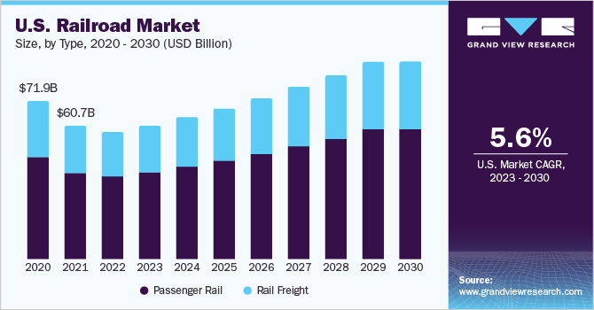
A
N
N
U
A
L
%
Biggest market end-users: Construction, Mining, Agriculture
The N. American market accounts for 30% of GLOBAL Revenue

Slide 46
BNSF Closes 2023 With Net Earnings, Volumes Down, BUT Warren is still proud of the company
Earnings reported on February 26, 2024
For 2023, BNSF posted net earnings of $5.087 billion, down 14% from the prior-year period;
revenues of $23.876 million, down 8% from 2022;
and total volumes (in thousands) of 9,003, down 6% from 2022’s 9,549.
“BNSF’s earnings declined more than I expected, as revenues fell,” Buffett wrote in his letter.
“Though fuel costs also fell, wage increases, promulgated in Washington, were far beyond the country’s inflation goals. This differential may recur in future negotiations.”
“Though BNSF carries more freight and spends more on capital expenditures than any of the five other major North American railroads [CSX, Norfolk Southern, Union Pacific, CN and Canadian Pacific Kansas City], its profit margins have slipped relative to all five since our purchase. I believe that our vast service territory is second to none and that therefore our margin comparisons can and should improve.”

Slide 47
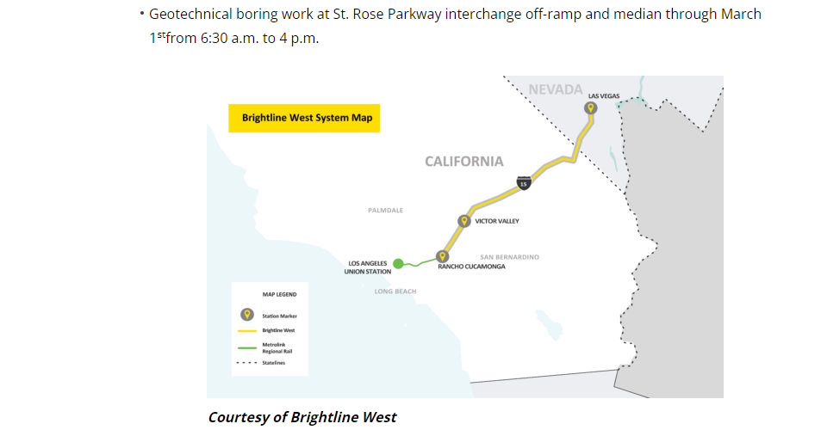
Daytime boring has started – got caught in traffic here and on I10 while returning from a recent CA trip.

Slide 48
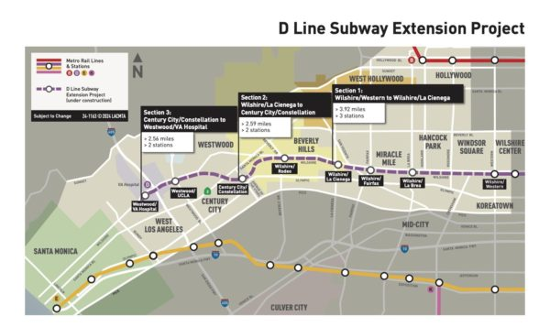
LA METRO
Has finished FIVE years of tunneling for D-line Subway Extension
Section One has a projected opening in 2025

Slide 49
More Infrastructure Projects follow-up from the Bipartisan Infrastructure Law
BALTIMORE –The Frederick Douglass Tunnel Program sees the beginning of demolition. The first of 47 residential and commercial properties that have been acquired by Amtrak are now under demolition. This will modernize a 10-mile section of the Northeast Corridor. (**The Baltimore Port is the largest single handler of car/van shipments *850,000 came through in 2023. With the bridge gone, both CSX and NS told customers that there would be delays in agricultural products, coffee & sugar).
DENVER: The Regional Transportation District (RTD) will begin a reconstruction project for light rail track in downtown Denver. They are removing ALL current rail infrastructure, concrete, ballasts etc. Starting in May, the first of multiple phases will focus on five segments of at-grade rail and street intersections in the Downtown Loop at $152 million. Phase 2,3 & 5 will begin in ‘25.
PHILADELPHIA: Amtrak states that six rail yards will be upgraded with new facilities to support maintenance, routine inspections, equipment repairs and service needs. Amtrak is investing $5.5 Billion for 2024.
All rail project information comes from RT&S Engineering’s latest March newsletter.

Slide 50
Archer Western-Turner Wins $855M Contract for DFW Terminal F
DFW Airport recently selected joint venture Innovation Next+ as the design-build contractor for its $855-million Terminal F and Skylink Station project. The Irving, Texas-based JV includes Archer Western Construction LLC, Turner Construction Co., Phillips/May Corp., H.J. Russell & Co. and CARCON Industries—plus design team members. The airport board voted on Feb. 1, 2024 to authorize a contract with the JV.
American Airlines signed a new 10-year lease agreement with the airport, which includes nearly $5 billion in capital.
Terminal F will be built to the south of the existing Terminal D, with an expected cost of $1.6 billion. The building will have 15 gates, and is scheduled to be completed in 2026. Terminal C will be renovated at a cost of $2.72 Billion
**THINK about what materials these projects will need and what companies will be providing products or services.
OMG: Boeing! United Airlines (suffering from pilot shortages YET) has asked pilots for voluntary leave for the month of May. Why? United uses Boeing jets for 81% of its mainline operations. The airlines are having to re-certify the airplanes they have – and are sure they will have to waste their dollars reviewing any new inventory.
Southwest which ONLY flies Boeing 737’s will hire about 50% fewer pilots and 60% fewer attendants than planned in 2024. **American and Delta accounts for about 50% of their fleet being Boeing made.
Meanwhile BA delivered 83 planes in the 1st Qtr. of 2024. Normal delivery numbers should be 150+ planes

Slide 51
*This man named Sam from Guangdong chose the Qin Plus plug-in hybrid from BYD.
At less than 100,000 yuan ($13,900), it fit his budget, and the ability to switch between battery power and an old-school internal combustion engine means he can save money on his daily commute and still take long road trips without worrying about recharging.
Last year, sales of plug-in hybrids increased 83%, compared with 21% growth for battery-only Evs. STILL, overall vehicle sales fell 14% last year (*China Passenger Car Association).
BYD sold 3 Million vehicles in 2023.
BYD became the best selling car brand in China last year. It overtook Tesla to become the world’s largest EV maker in this last quarter.

Slide 52
Consumer Reports 2024 –TOP 10 cars in each category:
Subaru Forester (Compact SUV)
Subaru Crosstrek (Sub compact)
Toyota Camry Hybrid (Midsize)
Toyota Prius / Prius Prime
Toyota Highlander Hybrid (Mid size SUV)
Toyota RAV4 Prime
Ford Maverick Hybrid Pick-up
Tesla Model Y (All electric)
Mazda 3 (small car)
BMW X5 PHEV (luxury)
**BYD keeps cutting prices. The Seagull hatchback EV is now less than $10,000 – global threat/competition
**03-22-24: Stellantis to cut 4000 white collar jobs in the U.S. (Jeep & Ram) to shift product line up toward EV’s
**04-15-24: Tesla will lay-off 10% of their workforce.

Slide 53
JOBY (*So Cool)
Joby Aviation expects to launch its flying taxi service first in Dubai. Work on a partnership with the Gulf emirate is “a bit more advanced in the approach that they’re taking,” Joby’s president of operations, said in an interview.
The Toyota-backed company said in February that it was targeting initial operations by 2025 in Dubai, where it won a six-year exclusive agreement to operate its electric air-taxi services.
Joby Aviation electric vertical take-off and landing aircraft / Bloomberg

Slide 54
NEW HOMES SALES --Plentiful Inventory Putting a Lid on Prices:
Inventory remains abundant in the new home market as inventory improved for a sixth consecutive month. The 456K homes in inventory translates to 8.3 months' supply at the current sales pace, down from 8.9 in November but level with December.
The median new home price rose 1.8% over the month to $420,700. New home prices have now fallen on an annual basis for five straight months, but January's decline was the shallowest since August 2023 when prices were essentially flat over the year.
Price dynamics remain favorable for buyers in the new home market compared to the resale market. The median existing single-family home price rose 5.0% year-over-year in January as tight supply for existing homes continues to place upward pressure on prices.
As mortgage rates have stabilized, home builders have pulled back on offering buyer incentives. Per the National Association of Home Builders February HMI survey, just 25% of home builders reported cutting prices, down from 31% in January and 36% in December.

Slide 55
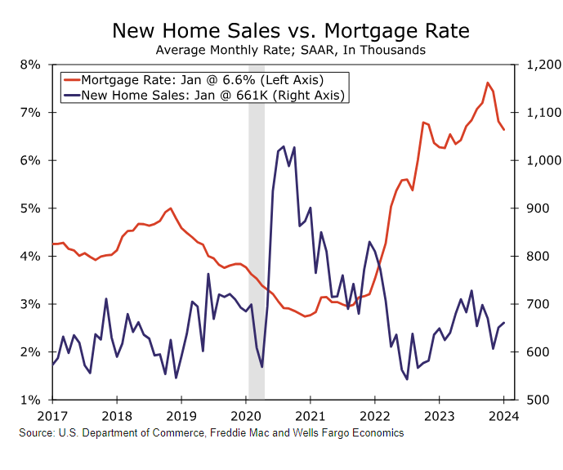
MORTGAGE RATES AT NEARLY 7% HURTS ---
BUYERS DON’T LIKE THE HIGHER FOR LONGER SCENARIO
NEITHER DO THE BUILDERS

Slide 56
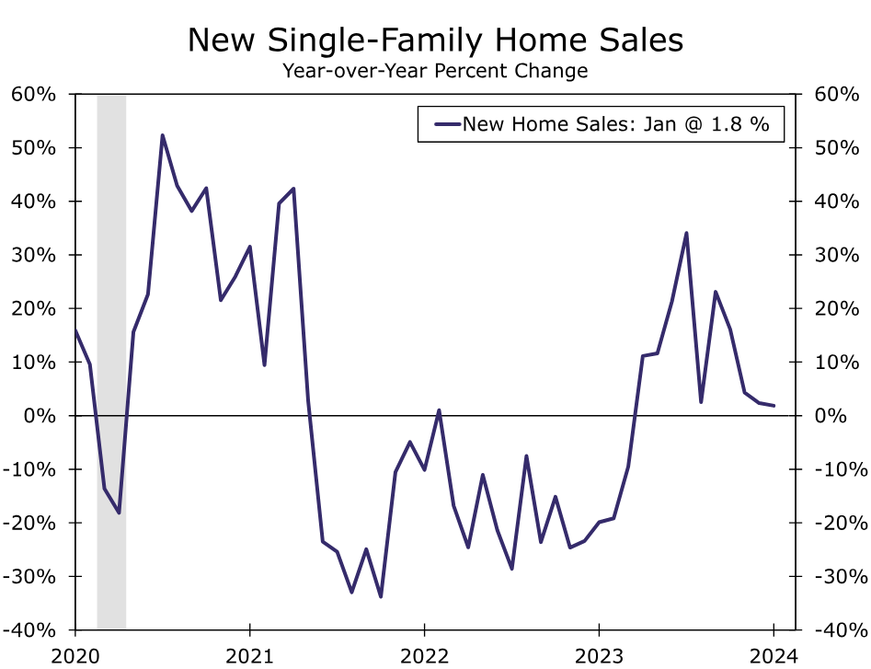
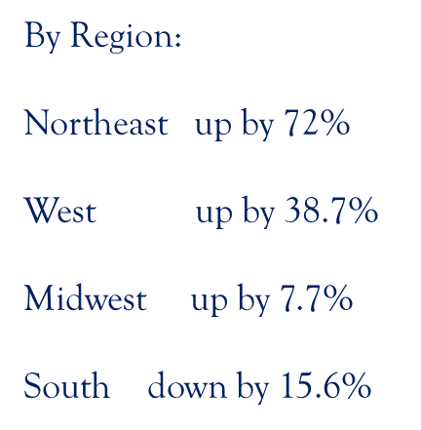

Slide 57
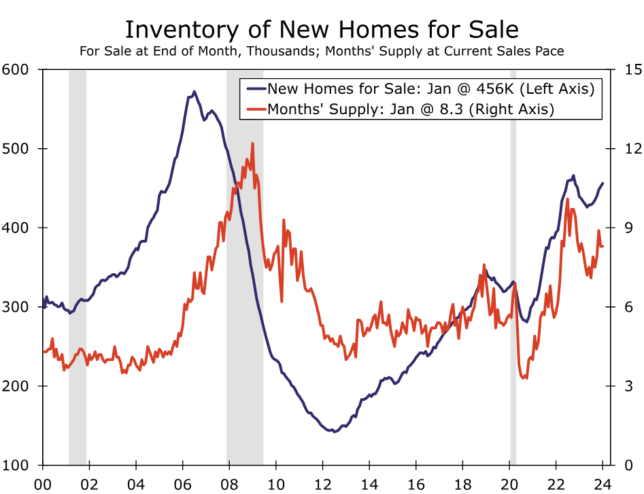
Most recent data on median new home price
Is
At
$420,700 !!!!!
January, 2024:
U.S. Dept of Commerce
Wells Fargo Economics
More recent news says prices dropped 3+%
Remember, real estate is local ---

Slide 58
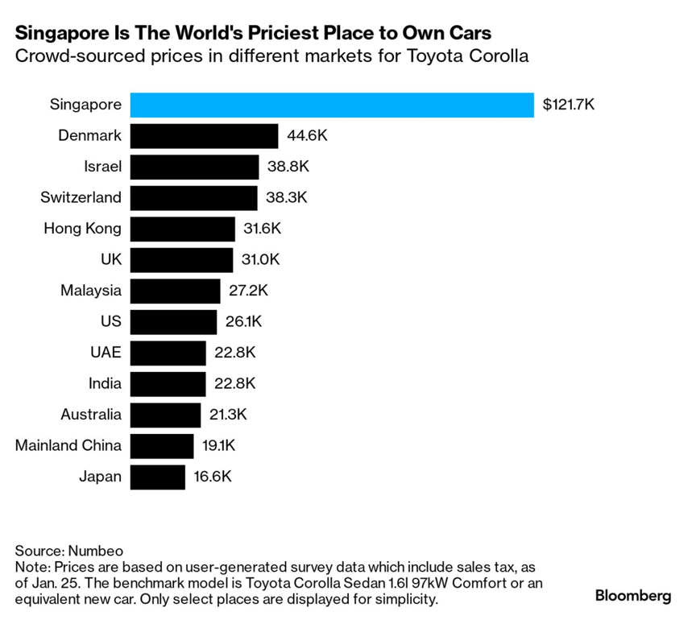
So a lady goes into the Toyota dealership to buy a Corolla and the dealership was asking S$260,000 ($193,870) for a hybrid.”
That’s the price for the car and the permit necessary (Certificate of Entitlement) to drive in Singapore, which is good for 10 years.
Singapore has more than 300,000 U.S. Dollar Millionaires (*From all over the world).
The U.S. car-buying experience is in reality inexpensive to downright cheap compared to the rest of the world.

Slide 59
SASTAMALA, Finland —
The race to stave off disaster in Ukraine’s war against Russia is unfolding in the battle-scarred fields, forests of Eastern Europe and, in a quiet wooded area of southwest Finland.
In an artillery factory, a mechanical arm lifts a mass of molten metal from the flames of a forging press. The red-hot steel cylinder will be cooled and packed with explosives before reaching its destination: bolstering NATO stockpiles or, perhaps, being fired down the barrel of a Ukrainian howitzer.
Workers at this plant, which now operates 24 hours a day, seven days a week, have increased their output of 155mm shells fourfold since Russia’s 2022 invasion of Ukraine.
Will this eventually lift stocks like LMT or RTX ?

Slide 60
Sample: ACTIVITY
BOUGHT 5 NOKIA OYJ ADR EACH REPR 1 ORD NPV 3.5400
SOLD 1 CALL (GILD) GILEAD SCIENCES INC 0.1500
SOLD 1 CALL (MMM) 3M CO 0.0800
SOLD 1 CALL (FNF) FIDELITY NATIONAL 0.8100
BOUGHT 3 CALL (BMY) BRISTOL-MYERS SQUIBB 0.0100
BOUGHT 1 CALL (USB) US BANCORP 0.0100
I was tempted to play options with ticker DJT but was afraid I would get stuck with it!!

Slide 61
Sample: ACTIVITY
SOLD 6 ALCON Inc. 086.50
SOLD 1 TAP *Molson Coors 062.16
*Needed some cash :Uncertain about ALCON’s immediate future, so sold, & sold off 1 TAP to cover.
BOUGHT 8 CROWN CASTLE INC COM 112.2900
*Added to position to lower cost basis as price had fallen past year & ex-dividend date is coming in a few days.
BOUGHT 1 U S BK NATL ASSN CD 1000.00
*Actually went out 18 MONTHS at 5.15%
SOLD ALL SCIENCE APPLICATIONS INTL CORP COM 142.4200
BOUGHT 5 COMCAST CORP 43.2900
BOUGHT 1 TYSON FOODS INC 57.4900

Slide 62
Sample: ACTIVITY
ACTVITY:
BOUGHT 1 PRICE T ROWE GROUPS COM USD0.20 110.8700
BOUGHT 3 PRICE T ROWE GROUPS COM USD0.20 119.3300
ACTIVITY OPTIONS:
SOLD 1 CALL (MS) MORGAN STANLEY COM 0.7300
SOLD 1 CALL (INTC) INTEL CORP COM 0.6300
SOLD 1 CALL (INTC) INTEL CORP COM 0.1500
SOLD 1 CALL (GSK) GSK PLC SPON ADS 0.4000 *(Rolled)
BOUGHT 1 CALL (GSK) GSK PLC SPON ADS 0.3000

Slide 63
The rapid aging of the U.S. population is quickly driving up the need for eldercare. We are not ready
Americans age 65+ account for a record 22% of the population. Over the next decade, the oldest group of Americans, (75+), are projected to account for more than ½ of the 19 million increase in the U.S. population. Reasonable assumptions would point to an additional 1.7 million seniors to require care a decade from now.
Women accounted for 59% of unpaid caregivers in 2021-2022. Older women (ages 55+) in particular are integral to the provision of care, comprising 30% of all unpaid caregivers.
In 2023, 1.9 million women ages 55+ were not in the labor force due to family obligations, seven-times the number of men of the same age group. Or relegate women to part –time employment which adds to a pay gap.
Women account for 82% of home health and personal care aids. The Department of Labor projects these jobs will increase 22% by 2032, and will probably still be under-paid.
In 2022, median pay for home health and personal care aides was roughly one-third below both the national median & the median pay in traditionally female-dominated jobs (financial clerks and secretaries/assistants).
*Edited from an article: March 5, 2024 Wells Fargo Economics

Slide 64
ARE WE STILL RECOVERING AFTER COVID ? OR IS THIS A PERMANENT CHANGE?
Walmart, four years after Covid-19 prompted curtailed hours, still hasn’t gone back to “open all night.”
Some supermarkets, electronics retailers, coffee shops and pharmacies that shuttered early during Covid-19 have never come back to late-night hours. Not even all of 24 Hour Fitness’ gyms — are open 24 hours.
(*YELP):24 Hour restaurants fell 18% from 2020 to 2024. NYC lost 13%, Los Angeles lost 35%, Chicago lost 10%
Pharmacy closures are creating pharmacy deserts in minority communities. Walgreens will shutter 450 more stores and CVS is scheduled to close 1,124. (*Boston University, March 25, 2024)
Manpower Group says almost 4 in 5 employers are struggling to fill job vacancies. (03-03-24)
There were 323 drugs in shortage in the first 3-months of 2024. That’s a 33% increase with the average shortage lasting about ½ a year. (04-13-24) Government data (*UGH! And my drug stocks are in the ditch!??)
In London, more than 3,000 venues have shut down stating that operating costs have gone up- with fewer customers
They cannot maintain costs. The UK is recovering from a technical recession and expect DGP to be at 0.3% in ‘24.

Slide 65
National Park Rangers
The hourly rate for park rangers can vary. Nationwide the average is $21/hr. Most average $400/week.
Seasonal employees range from $13 to $16.50/hr.
Many parks are miles away from a town – but at these wages, one could not afford to live in a town. Also housing on these parks are old and dilapidated.
Housing for rangers is an issue and recruiters are stymied. BUT – good news --
Yellowstone National Park received an anonymous gift of $40 Million for housing

Slide 66
FYI: The Financial Times reports that “America has essentially stopped building its own ships.” – over the past few DECADES.
The “Dali” was sailing into the Baltimore port, but the ship was constructed by the Korean firm Hyundai, operated by a crew of Indian nationals, owned by a Singaporean firm and carrying containers on behalf of a Danish shipping giant that was on route to Sri Lanka.
These trans-national systems are a result of globalization and booming economic times.
Beside running the risk of hitting a bridge ---
Running sideways and plugging up the Panama canal that backlog other ships ----
Or getting hit by missiles ----- disruption to our global shipping routes is a problem.
This is a picture of the sunken vessel “Rubymar” in the Red Sea after being struck by a missile fired by the Houthi militants *(Reuters) 3-3-24.
The ship flew the flag of Belize and was managed by a Beirut-based shipping firm, organized by a Lebanese operator and had mostly Syrian crew.

Slide 67
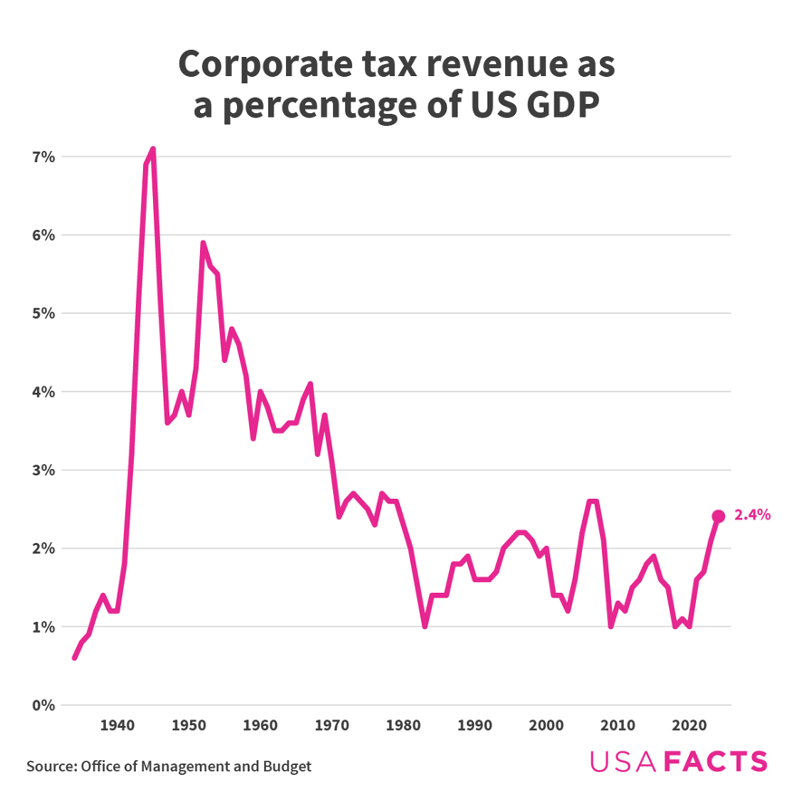
Corporate tax revenue has been
between 1% and 3% since the 1970’s.
The Inflation Reduction Act of 2022 amended the corporate tax structure to include a minimum of 15% tax on corporations with more than $1 Billion in average annual earnings over the past three years. This tax went into affect in 2023.
The prediction is that roughly 150 companies would be subject to this new minimum corporate tax annually.
It is anticipated that this move will increase revenue by $222 Billion over a decade. *I just hope global corps won’t hide revenue!

Slide 68
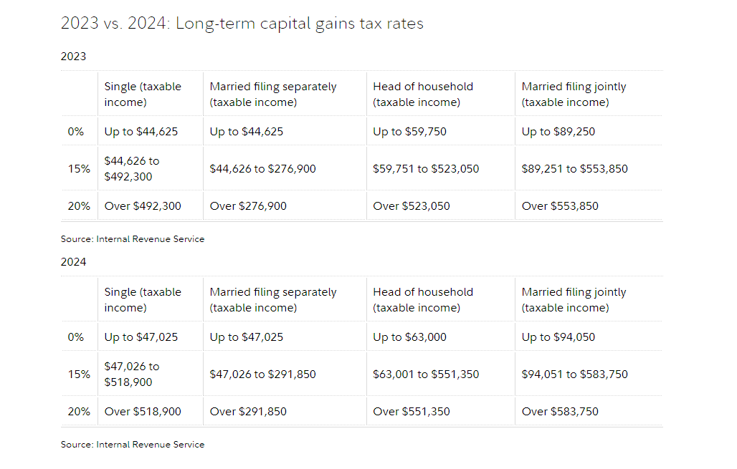
OU
T
S
I
D
E
O
F
I
R
A
A
C
C
T.

Slide 69
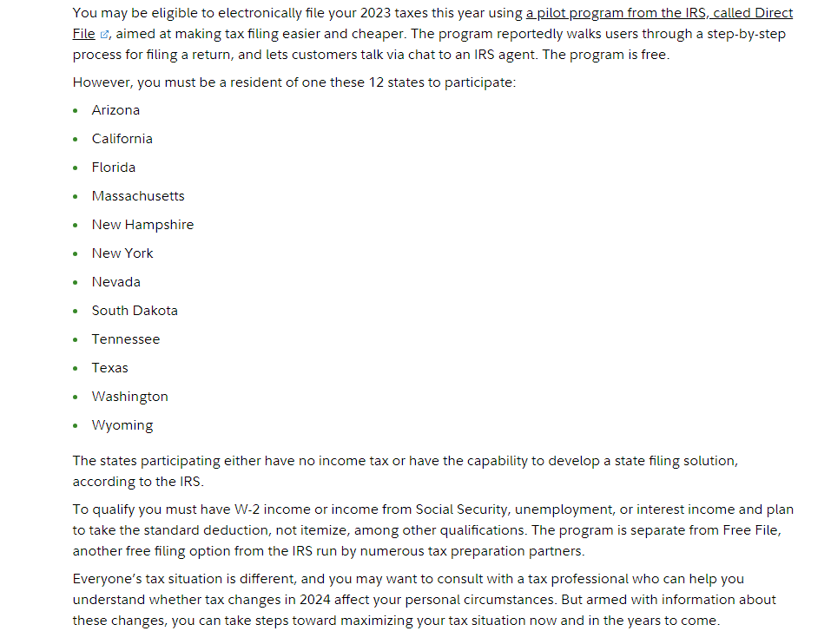
FREE TAX FILING
This comes from the IRS pilot program. There are apparently 7 screens of eligibility checklists – but once stated there are fewer questions than in Turbo Tax. You can’t use if you made more than $1500 in interest OR if you paid into an HSA
Also, you can file free with AARP in your local area.
**All have some restrictions. Can’t trade in crypto, or have a large Schedule C business or do LARGE itemizing.

Slide 70
AND WE SAY GOODBYE TO BOSTOM MARKET – FROM A 1990’S BOOM TO A BUST ---

Slide 71
The Tropicana, Las Vegas closed April 2nd to make room for a new major league baseball team,....
A 2024 picture,....
The demolition is to start in October.
to make room for the $1.5 Billion, 33,000 seat domed stadium for the Oakland A’s,...
... And more profitable gambling,...

Slide 72
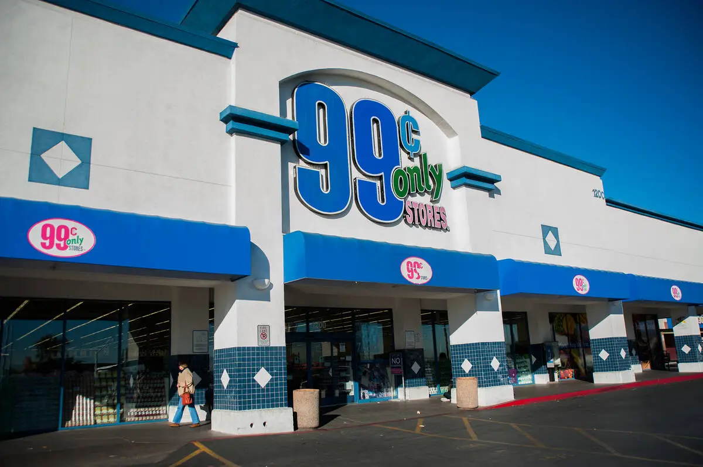
99 CENT ONLY
The owner of 99 Cents Only said it will close all 371 of its stores in the United States.
04-03-2024.
The company cited financial difficulties stemming from the “pandemic changing” consumer demand and rising inflation.

Slide 73
SIX YEARS AGO SPORTS BETTING
WAS ILLEGAL UNDER FEDERAL LAW
The American Gaming Assoc. estimates that $3Billion will be wagered during March Madness.
Americans wagered a record $119.84 Billion in ‘23 in sports betting.
58% of college students have placed at least one sport bet.
Meanwhile, the best base ball player on planet earth “SHOHEI OHTANI” recently hit his first home run as a Dodger --- I sincerely hope the gambling debt falls squarely on the shoulders of his interpreter.
P.S. The average cost of the Women’s Final Four ticket was DOUBLE the men’s (Women’s ticket coming in @ $2,323 and the Men’s ticket at $1,001)

