Slide 1
I am thrilled to say goodbye to 2023. I would call it a year of financial survival,..
Unless you only owned the Magnificent 7!
But then we had a Santa Clause rally,...
And we are still trying to figure out just what is going on?
Will the January Barometer give us a hint? (*the belief that so goes the S&P in January, so goes the market for the whole year)
Cash?
Equities?
Bonds?
WHO KNOWS for certain,.. But, we are still SLIDING INTO 2024,.....

Slide 2
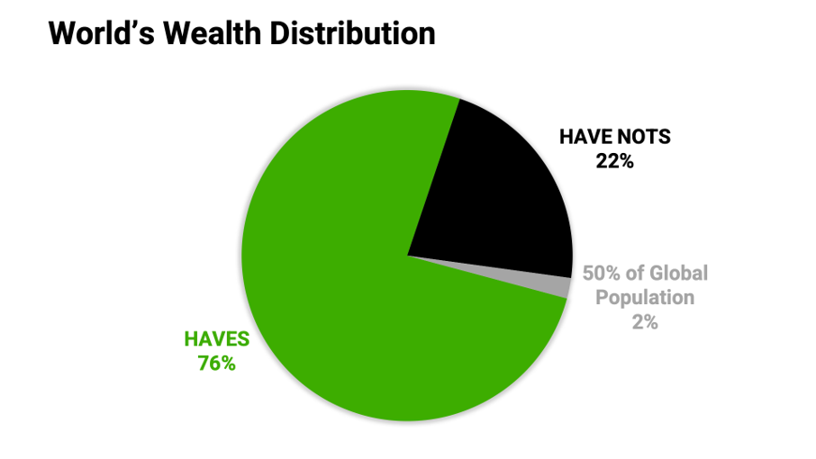
According to the 2022 World Inequality Report, the top 10% of the planet’s richest individuals own 76% of the world’s wealth while the bottom 50% of the global population possesses just 2%.
In the past decade, billionaires have seen their wealth expand by 109%
I am happy that we have many billionaires giving away to charities, but on a global scale, it doesn’t make sense to still have people starving.
2024 may be a harder year for many of the global poor!

Slide 3
So, Are You Rich? (Washington Post: Survey data 2022, from Pew Research, Gallup along with the SEC)
The middle half of Americans have a net worth between $27,000 and $659,000. About 8 percent of households had a negative net worth (they owed more than they owned), while about 1 in 10 holds more than $2 million.
So what counts as rich? That depends on who you ask: The SEC says high net-worth folks have over $2.2 Million.
There aren’t solid definitions for a word as loaded as “rich.” Wealth cutoffs for terms like “upper wealth tier” and “high net worth individual” range from $770,800 to more than $2 million.
The median household net worth of White people of similar age, education, and household structure is $145,400, compared to $55,000 for non-White people.
The gap persists even after controlling for age and education because Black and Hispanic people tend to have lower incomes and are less likely to receive familial financial support or invest in the stock market. The persistent Black-White wealth gap created a disparity so extreme that researchers estimate it would be nearly impossible to close even if financial opportunities were equal ever since.
Homeownership is KEY, but doesn’t guarantee financial stability. Mortgages are the largest source of debt for about half of Americans in the middle ranks of wealth, and a home’s value can’t be spent without selling it.
The wealthier the household, the more likely their assets are making money for them. (*Why we, at AAII study!)

Slide 4
Nope, ...not lying HERE,.... Read below
IN DECEMBER, midway through the month, J P Morgan CEO Jamie Dimon said: “This may be the most dangerous time the world has seen in decades, and that the wars in Ukraine, Israel and Gaza could have far-reaching impacts on global energy, food supply, trade and geopolitics. It could even, he said, lead to nuclear blackmail (using the threat of nuclear warfare as leverage to coerce another country into meeting certain demands). Geopolitical bad actors are the biggest macroeconomic risk.” I agree!,... BUT let’s measure the market on December 14, 2023
The S&P 500 is up by 9% since Hamas’ October 7 attack on Israeli citizens
The S&P 500 is up 10% since Russian’s full-scale invasion of Ukraine in February, 2022
It’s really (all about the FED, about the FED, No trouble,...it’s all about the FED,.... No Trouble,...)

Slide 5
Since Mid-December, the market has

Slide 6
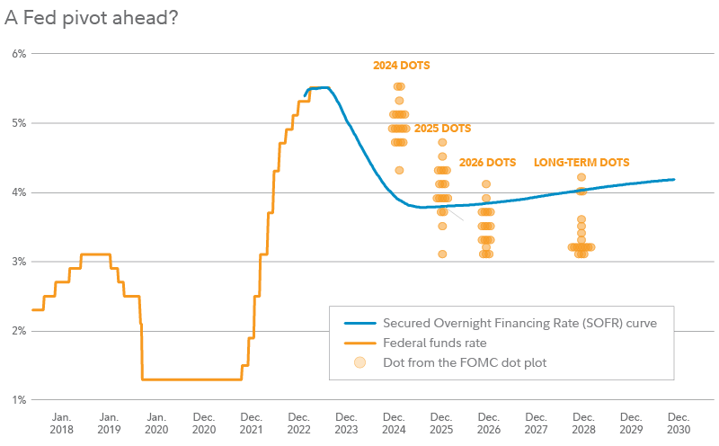
And here we have the dot plot --- which suggests 3 rate cuts in 2024
We have to be careful though as the market may be pricing in these rate cuts ALREADY
The Secured Overnight Financing Rate (SOFR) curve shows implied estimates for future interest rates that are embedded into current yield curves. Each dot represents an FOMC participant’s assessment of appropriate monetary policy for a future period, based on the dot plot released on December 13, 2023. Source: FMRCo., Bloomberg.

Slide 7
12 Reasons to Stay Aggressive in 2024 brian nelson, cfa, Valuentum securities inc. I highlighted in red to emphasize various points
1. The Fed has signaled that rate cuts could start with inflation at a 2 handle (2 point something) and not at exactly 2.0%. That means that the Fed may become anticipatory to prevent overshooting to the downside with inflation. We see this as positive for long-duration equities, particularly those whose free cash flow generation is robust in the out-years, inclusive of big cap tech and the stylistic area of large cap growth.
2. Unemployment is at structural lows of 3.7%. Employers are working hard to keep talent on board, and with each paycheck, employees are pumping more and more money into the stock market via retirement accounts. This tailwind remains a stiff one and will likely continue to be a strong foundation for the markets.
3. Employee wage gains have been phenomenal in recent years. Not only are employers starving for more help, but they are paying their workers considerably more. Wage hikes achieved through annual raises, worker strikes and ongoing hourly increases at the low end of the market should continue to propel consumer spending. Many have been talking about a soft landing in the U.S. economy, but there may be no landing at all as nominal GDP growth remains robust.
4. Short investors have been squeezed, and many have now closed shop. Famed short investor Jim Chanos recently closed his hedge funds, as the strong bull markets in 2021 and 2023 have put many a short investor’s back against the wall. We suspect short investing will continue to fall by the wayside as market tailwinds continue to propel the market ever higher this decade. A buy-the-dip mentality may define much of the next few years in the stock market.
5. Price agnostic trading is creating upside volatility. With only about 10% of trades these days coming from discretionary investors that are paying attention to fundamentals, we live in a market environment where investors are plowing money into broad indices just to capture the market return, not necessarily alpha. This should continue to benefit the largest companies in the largest indices, with big cap tech and large cap growth two categories primed to benefit.

Slide 8
6. The market is making a lot of sense again. With the 10-year Treasury meaningfully higher than that of the average S&P 500 company, broad-based dividend growth strategies have suffered, and risky high yield dividend stocks have fallen out of favor. Even after the huge gains in the Nasdaq and the stylistic area of large cap growth in 2023, we think the market continues to price stocks reasonably, offering a rational backdrop to stay aggressive with idea generation.
7. Our favorite stocks are back in vogue. 2022 was a difficult year for many strategies, but 2023 helped to rectify what we think was a year that didn’t make much sense across the marketplace. From 2022 through our latest measurement, both the simulated Best Ideas Newsletter portfolio and simulated Dividend Growth Newsletter portfolio have generated alpha against their benchmarks. The outperformance gives us confidence that 2022 was a blip in the longer-term trends that we like in big cap tech and the stylistic area of large cap growth.
8. We’ve yet to see capitulation in some of the weakest areas. Many REIT investors, for example, continue to be happy with their performance, where REIT equities have hardly delivered much of anything the past 5 years. One of the most popular REITs, Realty Income (O) is down on a price-only basis the past 5 years, while the broader REIT index continues to trail the market by a large margin on a total return basis. Positive sentiment continues in underperforming areas, helping to hold up some of the weakest areas of the market, more generally.
9. The huge step change in inflation will likely lead to a huge step change in market prices. If you’ve gone to a restaurant lately, you’ve probably noticed that menu prices are up significantly the past few years. Many households that have experienced huge wage gains are not balking at the higher prices, however, and we think higher prices are sticky across most areas of the economy, save for food-at-home goods, which may start to experience deflation. As the rising tide of prices flows across the economy, we expect a benign multiplier effect to continue to broaden out, paving the way for what could be a similar increase in nominal equity prices. Stocks doubling in the next few years would not surprise us.
10. Consumers are house rich and have fantastic balance sheets. More than half of households don’t have a mortgage and are benefiting from the massive wealth effect that has taken hold not only in equities the past decade but also with respect to housing prices the past few years. The average household today is now a millionaire, with a net worth over a $1 million (the median is much less, however) and we expect households to continue to spend lavishly in the wake of the massive wealth that has accumulated the past few years. Household balance sheets remain in great shape, and this is positive for both the U.S. economy and broader equity markets.
11. Artificial intelligence [AI] remains a huge source of upside potential. The release of ChatGPT turned our heads in a big way when it was launched, and we expect continued advancements in AI in the coming years. Microsoft (MSFT) has already started to monetize AI in Copilot, and while Nvidia (NVDA) and AMD (AMD) will benefit by providing the computing power behind the AI revolution, we're expecting many more companies to announce how they will tangibly monetize AI in 2024 and beyond, both with respect to expense management and revenue upside potential. We like the promise that AI holds.
12. Alternatives to stocks still aren't great. Even though certificates of deposit at the local bank are offering rates of 5% or more, 2023 showed that stocks could still deliver in a big way on a relative basis, with the S&P 500 up 24% in 2023 so far on a year-to-date basis. Some dividend-oriented investors may rotate into higher-yielding fixed income, pressuring dividend-paying stocks in 2024, but even a high-single-digit income yield may end up being less than what the market may deliver in the coming years. We would not be surprised if the broader S&P 500 generates double-digit annual returns over the next few years.

Slide 9
VBI (*Look for 6 and 7) and Fair Value Estimates
Not a recommendation from anyone here, but he noted these stocks
Let’s talk about a few of these.
What are your thoughts?

Slide 10
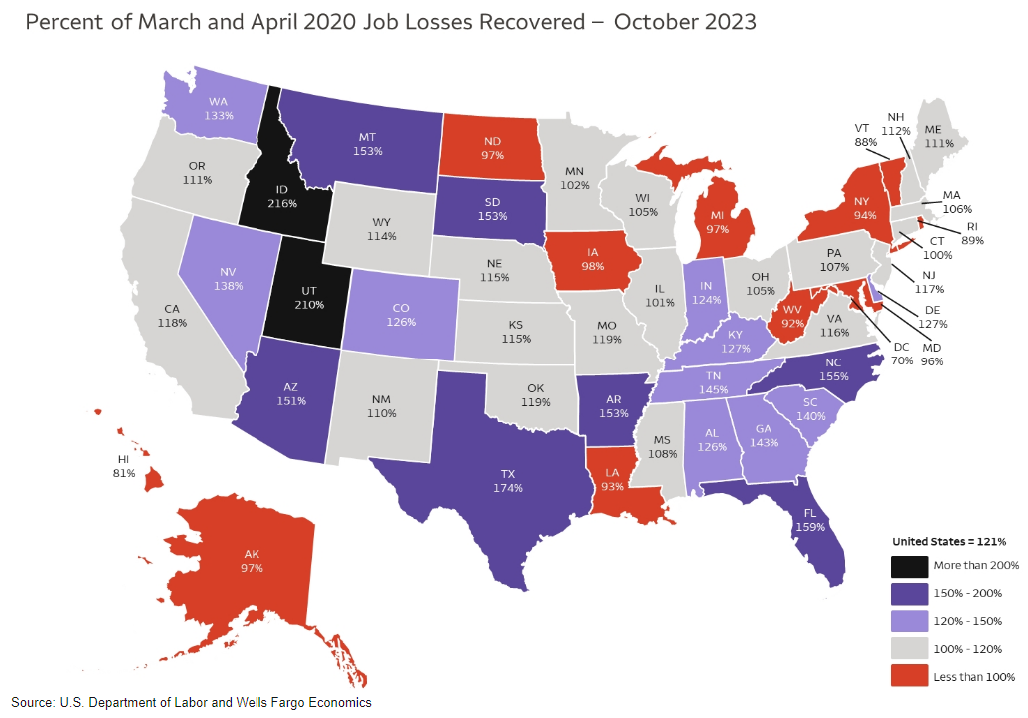
Job growth by area OR area’s that never recovered from Covid
States that have not come back to break-even from pre-covid jobs:
DC MD WV NY
RI VT NH MI
IA ND LA
AK HI
Many have popped to over 150% to over 200% !!!

Slide 11
Holiday Spending Review
Spending in 2022 showed a record sales (at that time) of $11.3 Billion on Cyber Monday.
2023’s spending on Cyber Monday came in at about $12.4 Billion (Adobe Analytics). About ONE-THIRD of that spending came between 6 PM to 11 PM that evening.
AND between 11-01 and 12-31 Americans spent a record setting $222 Billion online shopping.
Physical foot traffic was also up as indoor malls shot up 300% on Black Friday compared to the first three weeks of the month.
Consumers took advantage of Buy Now, Pay Later with increased usage up 14% from ’23 ($16.6 Billion).
The strong spending comes amid waning consumer sentiment and lackluster guidance from just about all the retailers. *It may mean weaker profit margins for many stores.

Slide 12
First Qtr. ’21 to
Third Qtr. ’23:
Credit card debt sits at an all-time high of $1.3 Trillion
The RATE of increase in credit card debt is double that of gains in mortgages.
The charts on the next few pages were culminated by Wells Fargo.

Slide 13
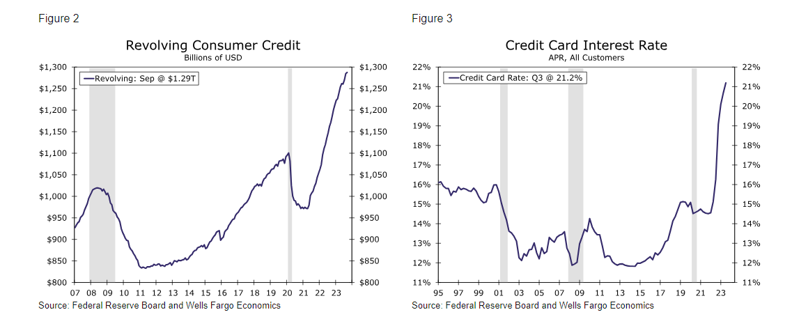
Revolving credit card debt STILL went up even though the interest rates on those debts shot sky-high

Slide 14
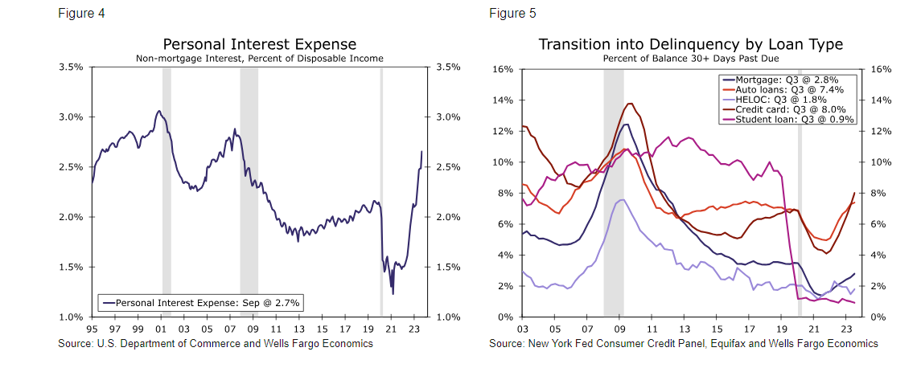
We closed out 2023 with personal interest expense as a % of our disposable income higher. Delinquencies too.

Slide 15
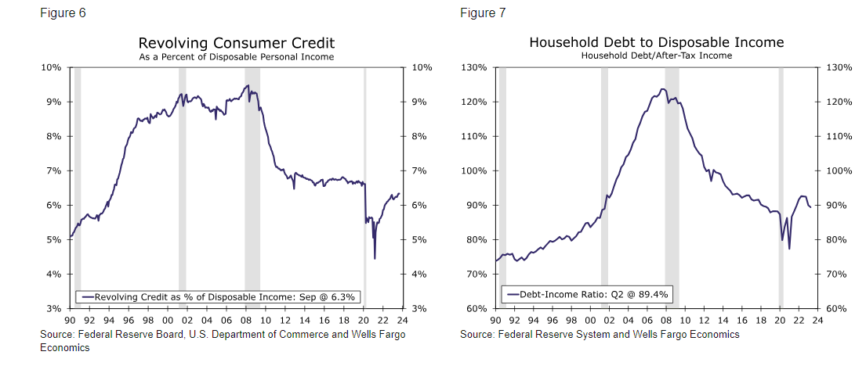
YET, revolving credit card debt only accounts for 6.2% of the household debt today

Slide 16
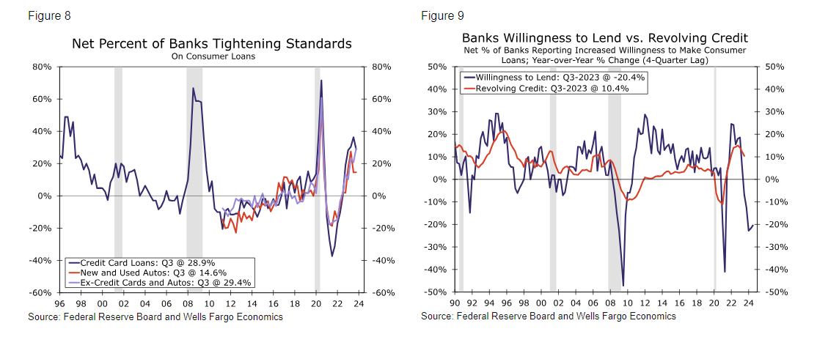
Banks are contracting their willingness to lend. This could be a headwind that will curtail consumer spending.

Slide 17
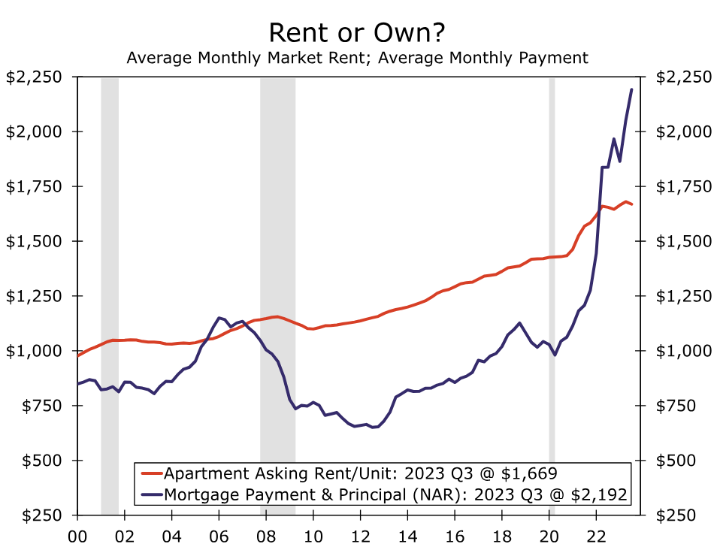
CONSUMER CHOICES:
From Wells Fargo:
Study the chart
It says it all
Wow, it is now cheaper to rent than to own! (*exception –folks with 3 % rates?)
Even if mortgage rates descend, single family affordability is likely to remain under pressure for the foreseeable future.

Slide 18
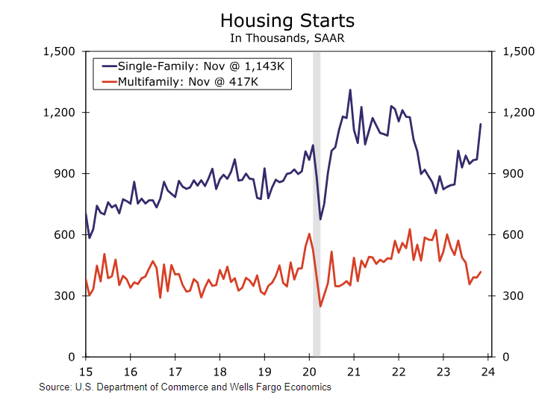
And yet,.. Housing starts = wow
This chart includes November data which surged 14.8%
Single family starts up 42.2% this year!
Multi- family permits YOY are down 33%
*I guess those several thousands being built now will suffice for the near future.
*The increase in new development has given way to higher vacancy rates and weaker rent growth in older rentals.

Slide 19
Holiday delivery – U.S. is behind in being “green”
In many countries, the last mile of delivery is done by EV vans etc. In the U.S. ,.....
Ford sold around 5,500 E-transit vans the first 9 month of ‘23 and GM’s Brightdrop has announced order of 27,000 but has only delivered a few hundred.
Rivian may do a deal with Amazon for maybe 65,000 EV delivery vans.

Slide 20
Besides the federal rebate to purchase an e.v.
States are looking to put together scrappage policies – surrender your combustion engine car and you will get a rebate for your new E.V.
Colorado launched a Vehicle Exchange Program in August & hands out a rebate of $6,000.
Vermont authorized a scrappage program in ’21 for up to $5,000.
California launched a program in 2014 to offer a rebate of $7,5000 just to switch to a ride-share and up to $9,500 for those buying an E.V.
IN THE U.S. 28 MILLION HOUSEHOLDS NOW OWN THREE OR MORE VEHICLES!
The average age of a car on the road rose 9% to 12.2 years OLD.

Slide 21
The Remarkable Resilience of Corporate Margins *Portions of an article, by Analyst, David Kelly at JPMorgan
The adjusted after-tax corporate profit share of GDP rose from an average of 6.0% between 1950 and 1995 to an average of 10.1% between 2012 and today – an increase of 4.1 percentage points.
Another important point is that businesses are having some success in holding the line on benefits. Between 2001 and 2015, hourly benefit costs grew at a 1.1% faster annual rate than wages. Since 2015, businesses have held the growth in benefits to a 0.4% slower annual rate than wages.
This reflects a historic decline in long-term interest rates from the early 1980s, when Baa corporate bond yields peaked at over 17%, to the pandemic recession when they fell to nearly 3%. Since then, they have backed up sharply with other interest rates and currently yield over 6%.
Currently almost half of the outstanding debt of the S&P500 companies (ex-financials) matures after 2030 with no more than 7% maturing in any year between now and then.

Slide 22
Article cont’d: The remarkable resilience of corporate margins
Various federal and state tax breaks have reduced the corporate tax share of GDP in the second half of the 20th Century. Since 2000, corporate taxes were fairly steady as a share of GDP until the passage of the 2017 Tax Cuts and Jobs Act which permanently reduced the federal corporate income tax rate from 35% to 21%. The 2022 Inflation Reduction Act marginally increased corporate tax revenue by assessing a 15% alternative minimum tax on book income.
However, in 2025, ...Washington will have to address the expiration of many tax breaks for individuals from the 2017 tax law. While the 21% corporate tax rate is not one of these provisions.
My take-away from the article was that Congress is not going to tax corporations in 2024/2025, especially if there is a HINT of a recession, and will have to look elsewhere to gain revenue.

Slide 23
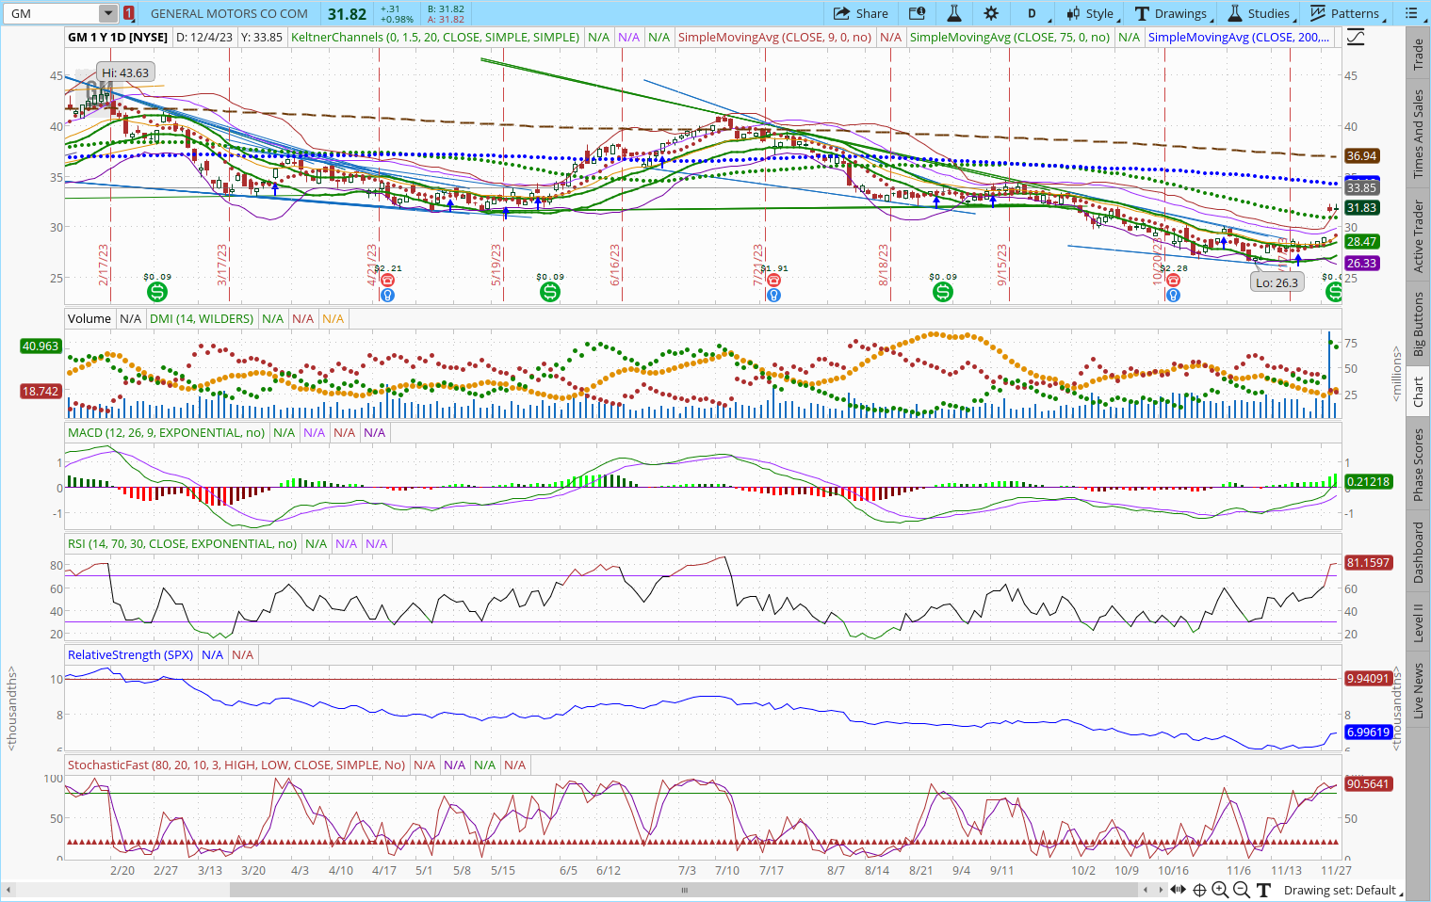
General Motors, fresh off bruising wage negotiations with its labor union and eager to goose its stock price, announced billions of dollars’ worth of cash returns to share- holders. Stock jumped 10%
In February GM was priced at $43+/Share. It recently dropped down to $26+/share.
The announced buy back popped the stock up to $31+ on that announcement alone.
This is just weeks after GM execs argued that they couldn’t afford pay raises.
The company expects a full year profit of $11 to $12 Billion

Slide 24
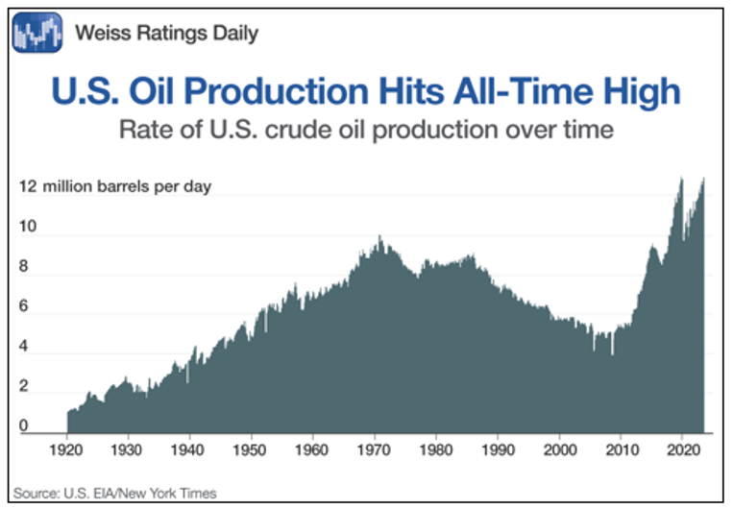
Now to oil – expect a wild ride.
There is plenty of oil as the new U.S. averages are over 13+million BPD. That is more than Saudi Arabia OR Russia produce.
Analysts expect the industry to add another 500,00 BPD in ‘24!
There are many influencers here but if you see a pull back in the oil service sector, maybe study them!
Remember, we got to this place of dominance by learning the lessons of the Gulf War back in the 1990’s. The U.S. pivoted our energy policy
to become more self sufficient.

Slide 25
Washington Post Opinion column 11-21-23 (Data from the Urban Institute Report)
Researchers calculate that a single man who earned the average wage every year of his adult life before retiring in 2020 at age 65, for instance, paid roughly $470,000 in taxes into the Social Security and Medicare systems. But he can expect to receive benefits equal to $640,000 over the course of his retirement. (*Taken into account, inflation, life expectancy and the worth of the tax payments collected)
Or consider a couple with one average earner and one low-wage earner. Their taxes reached $680,000 if they retired in 2020; their benefits are expected to total nearly double that, at $1.24 million. Most other marital and wage combinations show similar results. (see chart on the next page)

Slide 26
In other words, even under relatively generous assumptions, the typical elderly American has not fully “paid for” their benefits, despite widespread perceptions to the contrary

Slide 27
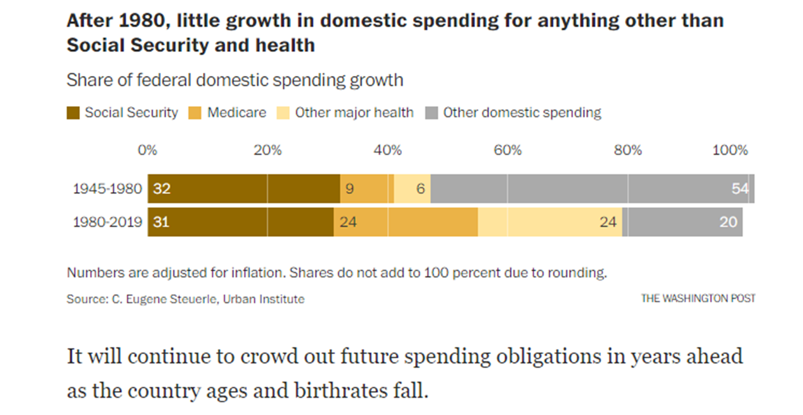

Slide 28
SOLD ALL ASTRAZENECA ADR REP 0.5 ORD 063.2201
SOLD ALL NOVO NORDISK A/S ADR-EACH CNV INTO 1 101.4500
BOUGHT 2 UNITED PARCEL SERVICE INC CL B 149.8800
SOLD 4 CALL (BMY) BRISTOL-MYERS SQUIBB .0600
BOUGHT 10 PRICE T ROWE GROUPS COM USD0.20 099.8600
BOUGHT 5 REGIONS FINANCIAL CORP NEW COM 016.5900
BOUGHT 3 US BANCORP 038.1200

Slide 29
BOUGHT PRICE T ROWE GROUPS COM USD0.20 99.2200 BOUGHT HILLENBRAND INC 39.6500 BOUGHT TELUS CORPORATION COM 18.9400
BOUGHT CALL (CLF) CLEVELAND-CLIFFS INC .1500
SOLD CALL (CLF) CLEVELAND-CLIFFS INC .2700
SOLD CALL (GSK) GSK PLC SPONSORED .1000
SOLD CALL (TROW) PRICE T ROWE GROUPS .2500
SOLD CALL (MS) MORGAN STANLEY COM .4700
SOLD CALL (GILD) GILEAD SCIENCES INC .0800
SOLD CALL (MMM) 3M CO .0600
**Note: the premium is awful – I went way up and out for a small amount of time.

Slide 30
BOUGHT 1 TYSON FOODS INC 51.7700 BOUGHT 2 TYSON FOODS INC 52.6100 BOUGHT 5 QUICKLOGIC CORP COM NEW 13.3300
SOLD 1 CALL (CSCO) CISCO SYSTEMS INC .0900
SOLD 1 CALL (GILD) GILEAD SCIENCES INC .4100
SOLD 4 CALL (BMY) BRISTOL-MYERS SQUIBB .1300
BOUGHT 1 PRICE T ROWE GROUPS COM USD0.20 107.9500
BOUGHT 1 PRICE T ROWE GROUPS COM USD0.20 107.6500
BOUGHT 2 UNITED PARCEL SERVICE INC CL B 156.7800
BOUGHT 1 PRICE T ROWE GROUPS COM USD0.20 108.6300
BOUGHT 1 UNITED PARCEL SERVICE INC CL B 157.5900
BOUGHT 1 CROWN CASTLE INC COM 115.4800

Slide 31
BOUGHT 2 BAXTER INTERNATIONAL INC COM USD1.00 38.4700
SOLD 7 WK KELLOGG CO COM SHS 13.7300 * Earlier Spin-off
BOUGHT 2 BANK OF NOVA SCOTIA COM NPV 47.5500

Slide 32
A report from McKinsey Global Institute said that remote work risks wiping $800 billion from the value of office buildings in major cities worldwide by 2030
The outlook for office buildings in 2024 isn’t very rosy.
CBRE, a commercial real estate services firm, said in estimates released Thursday that US office vacancy will likely increase further next year, reaching a 19.8% vacancy rate, up from 12.1% at the end of 2019.
Getting employees back into offices hasn’t been easy. In some cases, employees are protesting return-to-office mandates, such as at X, formerly known as Twitter.
The demand for office space will likely remain weak. “Office construction will slow to the lowest level since 2014, raising the prospect of a shortage of available Class-A space later in the year,” Beware of your REIT holdings as they may continue to deteriorate.

Slide 33
Bed Bath & Beyond left hundreds of vacant stores to be auctioned off in bankruptcy agreement
The auction is attracting big chains like Burlington, Michaels, Barnes & Noble, Macy’s and HomeGoods. Also moving in: Indoor pickleball courts, trampoline parks and bowling alleys. (CBRE)
Most of them are in the suburbs, and under 50,000 square feet — big, but not mega-store big.
Remember,.. Overstock.com bought the brand out of bankruptcy and has relaunched it online, complete with the beloved 20% coupons.
There hasn’t been much new retail space built since the 2008 financial crisis, and the rise of online shopping, retail and real estate experts say, all put a damper on building. *SO, maybe these properties will sell rather quickly??

Slide 34
ETF’s in 2023 *Data as of December 08, 2023
ETF closures jumped 52% to 243 so far this year, compared with 159 in 2022, according to Bloomberg.
Bloomberg reported that about 430 funds have launched so far this year, which it called a record.
Site, etf.com reported last year that 431 opened in 2022.
As ETF issuers continue to look for markets not addressed by already existing funds, a handful of niche ideas have had a short shelf life and have withered on the vine. Those that maintain participation rebalance every quarter.
“The large number of closures this year are the result of the large number of launches in recent years,” explained etf.com analyst Sumit Roy. “Not every fund idea is going to gain traction with investors and those that aren't profitable for their issuers tend to be shut down eventually."

Slide 35
So, how many ETF’s do we have? AND,... Some Predictions by Morningstar
Morningstar said there is a lengthy list of 3,300+ ETF’s currently available to the U.S. investor.
More than 1,200 have LESS THAN $50 Million in assets so they haven’t gained traction.
Almost 500 of those with $50+ Million have been around for three years or longer.
At some point, the costs of providing these ETF’s outweigh the revenue they generate. (Higher fees?)
The bond ETF’s will have increased flow IN led by active ETF bond funds. (Blackrock, Vanguard)
Alternative ETF’s is expected to pick up steam. (*Think hedge fund type ETF’s)
Covered call ETF’s will loose steam. (*Think opportunity costs in a runaway market)

Slide 36
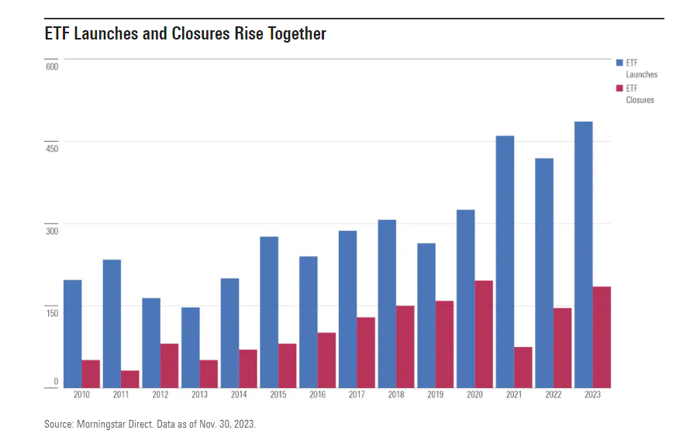
In each of the last 3 years, ETF providers launched more than 400 each year.
New launches in 2023 have surpassed 500. (*Some are leveraged, inverse single-stock, AI themes etc.)
Exception of COVID impact, (*like ‘21) closures have been climbing each year.
Best new ETFs of 2023
(* Per Morningstar):
*BlackRock Flexible Income
ETF BINC
*Schwab High Yield Bond
ETF SCYB

Slide 37
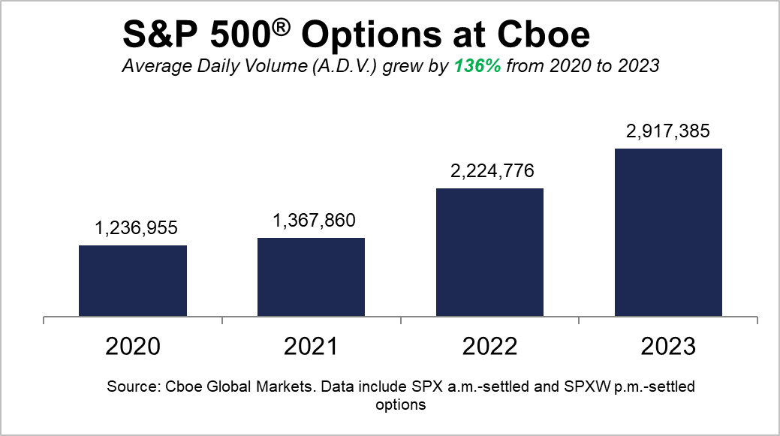
What about Options Trades? WOW --
The average daily volume for the S&P grew by 136% from 2020 to 2023.
The Financial Times noted that newer ETF’s backed by covered calls had a influence on the market along with the every day investor looking for income.
Hmmm,... Is this why I get no alpha in my premiums now?
Thoughts? – or just VIX influence?

Slide 38
So, what has AI been doing in all this?
The period from 1950-1970 is generally considered the “golden era” of antibiotic discovery, but thanks to artificial intelligence, scientists recently identified the first new class of antibiotics in decades. Researchers at MIT used a type of AI called deep learning to identify chemical structures associated with antimicrobial activity and then pick out the strongest ones, per a press release from the university.
They then discovered that the compounds spotted by the deep learning models were able to kill methicillin-resistant Staphylococcus aureus — a bacterium, often called MRSA, that leads to more than 10,000 deaths in the U.S. every year.
The results could help scientists design additional, and potentially more effective, medications. “The insight here was that we could see what was being learned by the models to make their predictions that certain molecules would make for good antibiotics,” said James Collins, who co-authored a study on the findings.
He added: “Our work provides a framework that is time-efficient, resource-efficient, and mechanistically insightful, from a chemical-structure standpoint, in ways that we haven’t had to date.”

Slide 39
The National Defense Authorization Act for fiscal 2024 includes the American Security Drone Act, which prohibits the government from using federal funds to purchase drones made in China or certain other countries starting in December 2025, with the measure in force through December 2028. It prohibits federal agencies from operating Chinese drones for that duration, unless they have an exemption.
*Skydio is the leading U.S. drone manufacturer using AI. The following link holds the list of U.S. Drone Manufacturers
https://www.modalai.com/pages/2024-u-s-drone-manufacturers-comprehensive-list
Construction of the U.S. Army Corps of Engineers’ $3.2-billion New Lock at the Soo project in Sault Ste. Marie, Mich., is advancing. The Corps awarded a $213.8-million contract option Phase 3 to Kokosing/ Alberici/ Traylor LLC for construction of the lock wall monoliths.
The project is replacing two smaller locks with one equal to the Poe Lock, which is the only Soo Lock on the St. Mary's River, between Michigan and Ontario, Canada, that is capable of accommodating modern “laker” shipping vessels. The scope of the contract option includes construction of 21 chamber monoliths for both the north & south walls of the new lock, according to the corps project design engineer. Each of the monoliths are about 44 ft wide and 70 ft tall, and will be built by placing concrete in 5-ft-high lifts
The Corps has previously awarded three other contract options worth a combined $281.3 million. Since mobilizing in late 2022, the contractor has placed cells for upstream and downstream cofferdams, started construction of a bridge to a mid-river hydropower plant, stabilized the existing monoliths, installed a grout curtain ahead of dewatering, conducted blasting/excavation for a planned utility shaft.
“Construction will continue over the winter season, to include hazardous waste abatement, concrete demolition, utility shaft excavation and electrical work,” said Mollie Mahoney, Corps senior project manager, in a statement.
Unmanned Aerial Systems (UAS) (DRONES) are operated by certified remote pilots (Currently have 399 fully trained) that provide advanced capabilities and support to U.S. Army Corps of Engineers for use in surveying, water rights flow, etc.

Slide 40
Charlie Munger Quotes (November 28, 2023)
I constantly see people rise in life who are not the smartest, sometimes not even the most diligent, but they are learning machines. They go to bed every night a little wiser than when they got up and boy does that help—particularly when you have a long run ahead of you.” - 2007 USC Law School Commencement Address
“We were not ideally located to be high-tech wizards. How many people of our age quickly mastered Google? I’ve been to Google headquarters. It looked to me like a kindergarten.” - Berkshire Hathaway meeting, 2018
“We have computers with algorithms trading against other computers. We’ve got people who know nothing about stocks, being advised by stockbrokers who know even less.” - Berkshire Hathaway 2022 meeting

Slide 41
Cont’d:
“A lot of people with high IQs are terrible investors because they’ve got terrible temperaments. And that is why we say that having a certain kind of temperament is more important than brains. You need to keep raw irrational emotion under control. You need patience and discipline and an ability to take losses and adversity without going crazy. You need an ability to not be driven crazy by extreme success.” - Kiplinger, 2005
“You’ll do better if you have passion for something in which you have aptitude. If Warren Buffett had gone into ballet, no one would have heard of him.” – Berkshire Hathaway annual meeting, 2008
“Invest in a business any fool can run, because someday a fool will. If it won’t stand a little mismanagement, it’s not much of a business.” - Poor Charlie’s Almanack

Slide 42
Con’td:
“Invert, always invert: Turn a situation or problem upside down. Look at it backward.” - Poor Charlie’s Almanack
“It’s so simple. You spend less than you earn. Invest shrewdly, and avoid toxic people and toxic activities, and try and keep learning all your life, etcetera . And do a lot of deferred gratification because you prefer life that way. And if you do all those things you are almost certain to succeed. And if you don’t, you’re gonna need a lot of luck.” - Poor Charlie’s Almanack
“If I can be optimistic when I’m nearly dead, surely the rest of you can handle a little inflation” – 2010 annual Berkshire Hathaway meeting.

Slide 43
Rich & Powerful countries have fallen – why?
There was a time when the sun never set on the British Empire and all roads led to Rome, but there has never been a larger contiguous land empire than that of the Mongols. Established in 1206 by Genghis Khan — means “universal ruler” — the empire eventually reached a size of at least 9 million sq. miles. Born Temujin, Genghis Khan rose to power from a tumultuous childhood, and the Mongols were a nomadic people whose territorial expansion came about largely due to brutal military tactics and fierce pragmatism.
At its peak, the empire included all of modern-day China & Mongolia in addition to parts of Armenia, Georgia, Russia, Ukraine, Romania, Iran, Iraq, Pakistan, Uzbekistan, Afghanistan, and Korea, among others. For all of Genghis’ savvy, however, his descendants proved a fractious bunch who fought among themselves and oversaw his empire’s decline; (* with the exception of his grandson Kublai Khan, few others in the dynasty are recalled fondly).
Genghis’ massive effect on the world might be summarized by two staggering statistics: He was responsible for the deaths of 11% of the world’s population at the time, and 1 in every 200 men living today are his direct descendants.
I am hopeful that Congress learns from history lessons like these. Be cordial and focus on what is best for the country. The world is at a tipping point where calm heads need to prevail and focus on doing the job of running the country, not how to tear it apart. P.S. I DO NOT WANT CONGRESS TO BE RESPONSIBLE FOR 1 OF EVERY 200 DECENDANTS IN THE U.S. – I WOULD WALK INTO THE OCEAN!!

Slide 44
This is the year of elections & the voter 2024 is important for the whole globe
More than 60 countries, with some 4 billion people, are set to stage national elections in 2024.
That means roughly 1/2 the planet could go to the polls in the greatest rolling spectacle of democracy in human history.
We won’t see this number of elections again until 2048
According to Freedom House, a Washington think tank that monitors the health of democracies, global freedom declined for the 17th consecutive year in 2023.
The U.S. and Indian outcomes may underscore a deepening appetite for norm-bending strongman rule (authoritarians)
“We’re electing illiberal leaders democratically,” Maria Ressa, a prominent journalist and Nobel laureate from the Philippines, said during an address to the National Press Club in Washington in September.
“We will know whether democracy lives or dies by the end of 2024.”

Slide 45
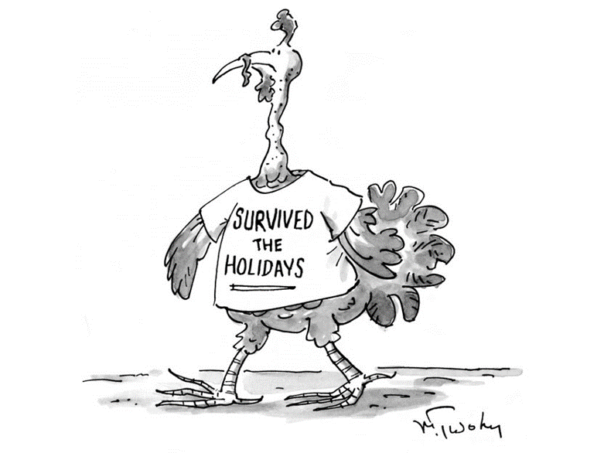
We managed to close out 2023 & survived okay
Since 1903, the U.S. stock market closes the day by ringing a bell. Prior to that it opened and closed by the ringing of a Chinese gong.
Not ALL stock markets have modernized their bells. The Euronext Amsterdam stock exchange is the oldest in the world and has opened and closed with a gong since the 17th century. Now, that’s a survival story ---

